Slide 1
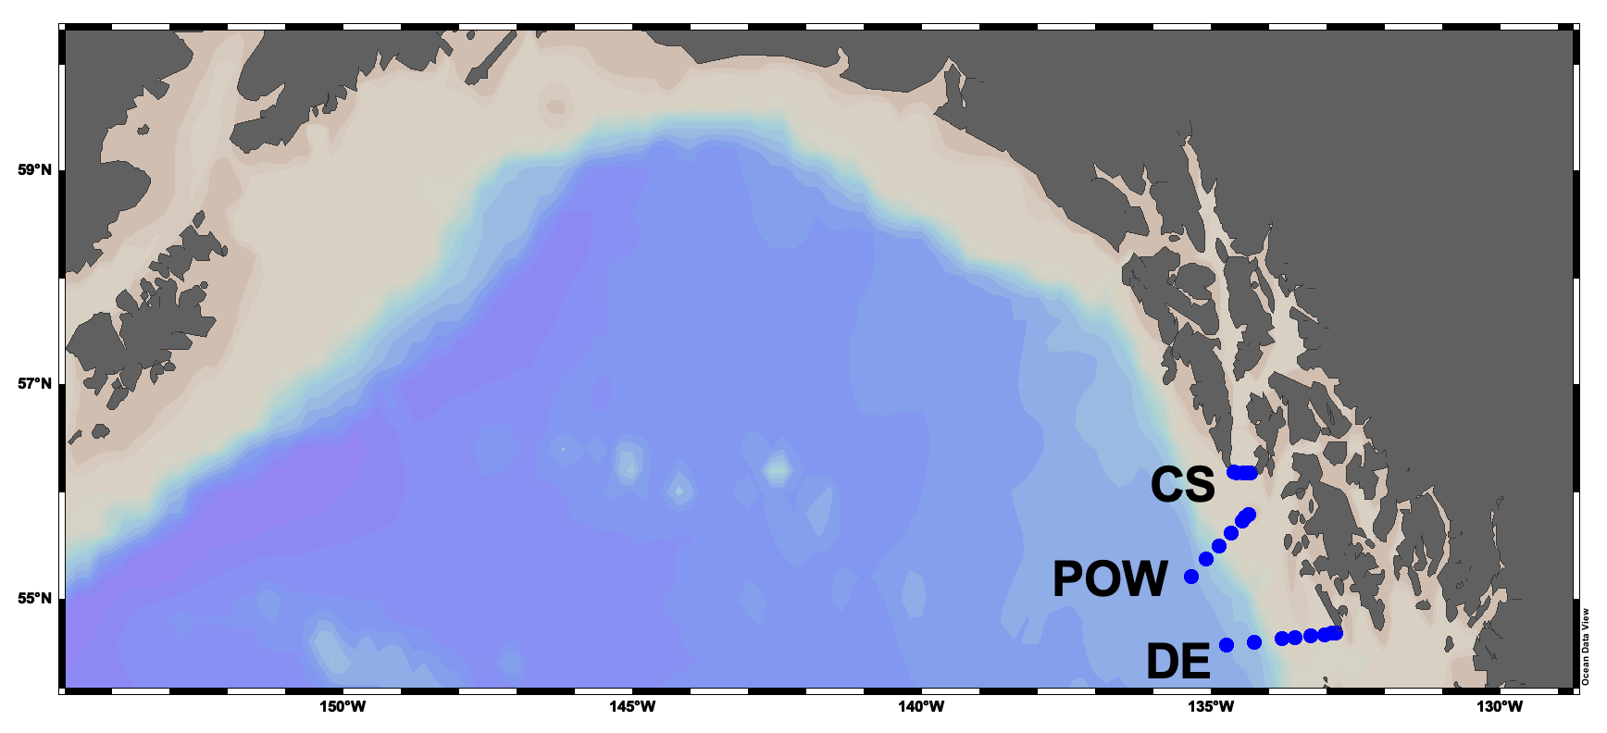
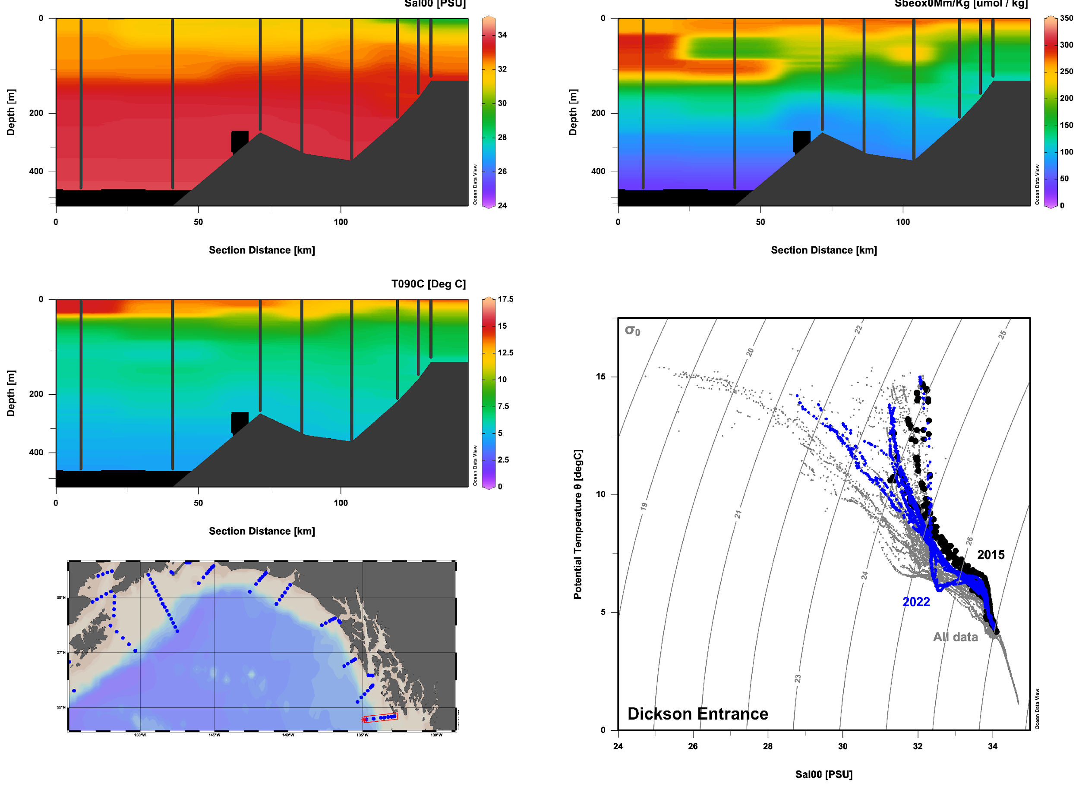
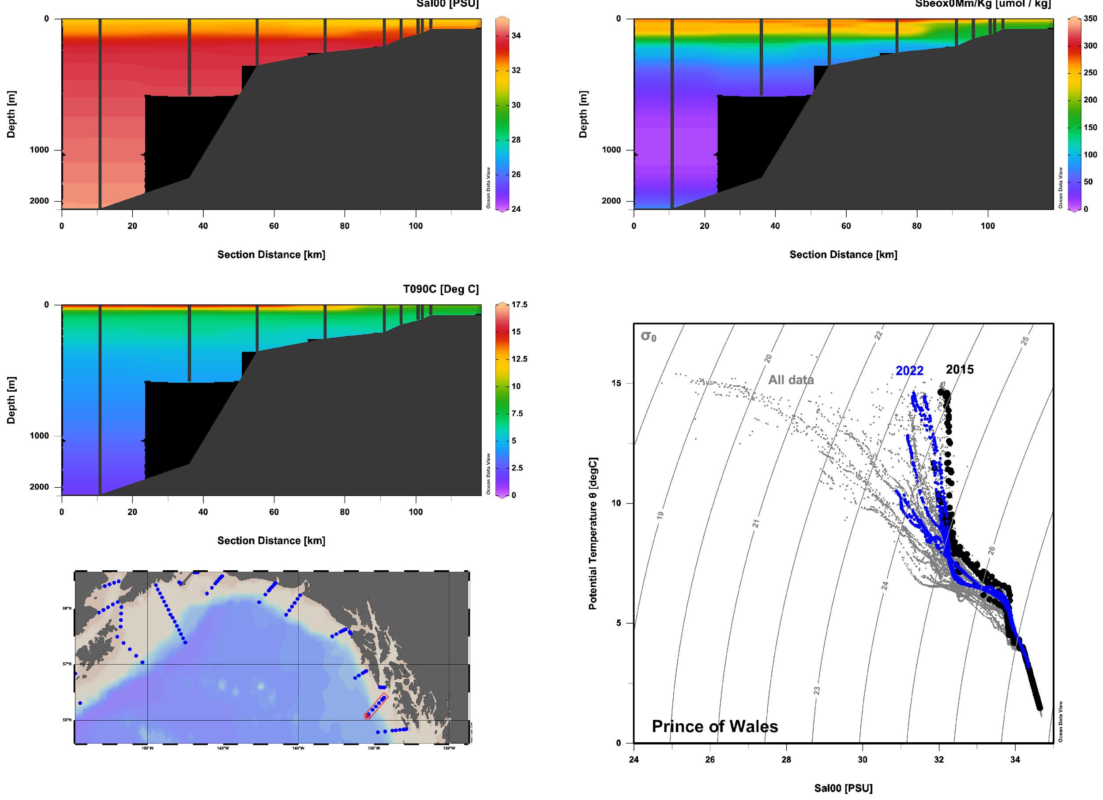
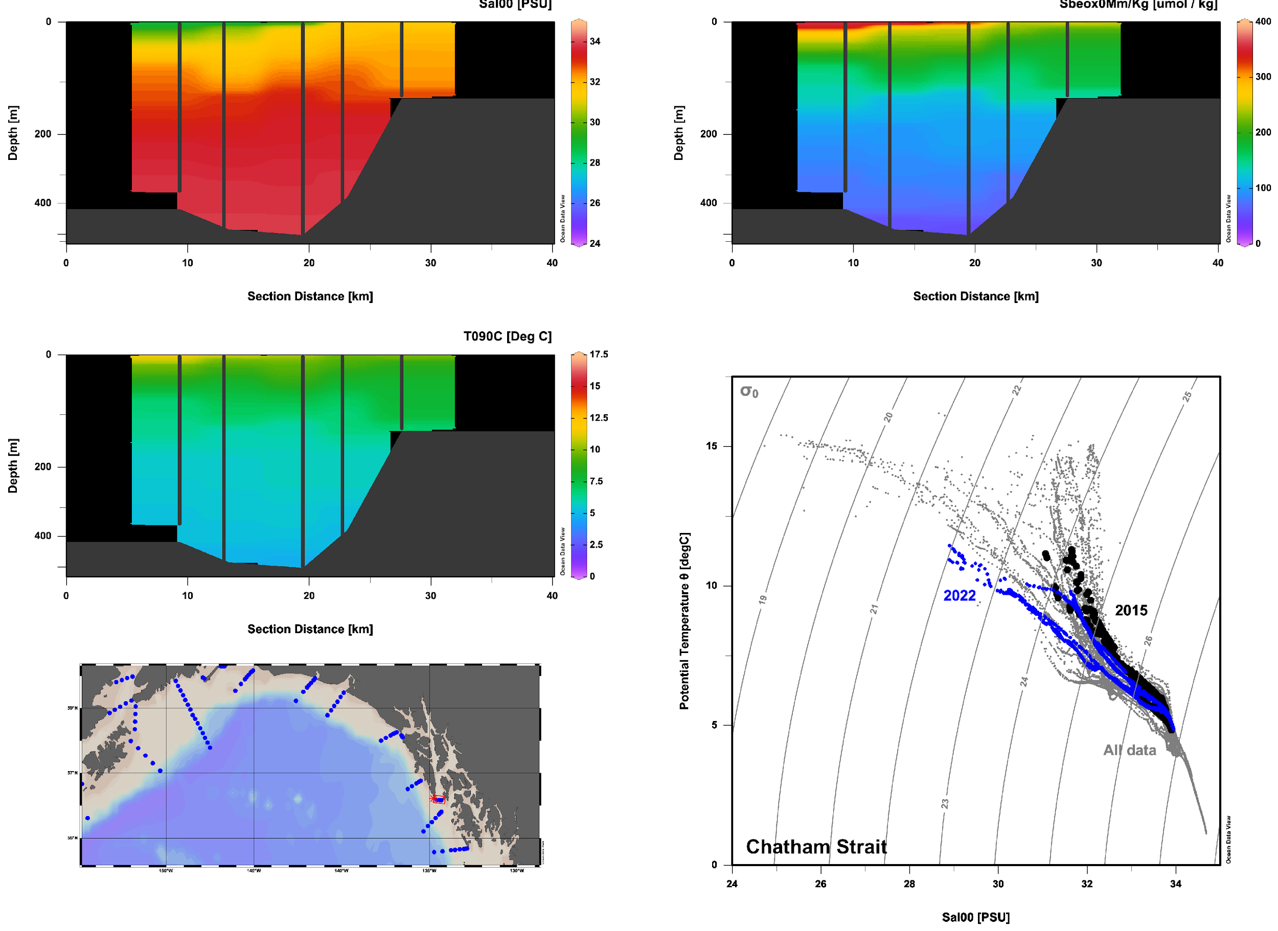
Water masses 2015 vs 2022 2022 is cooler and fresher than 2015: MHW abated; La Nina signal?

Slide 2
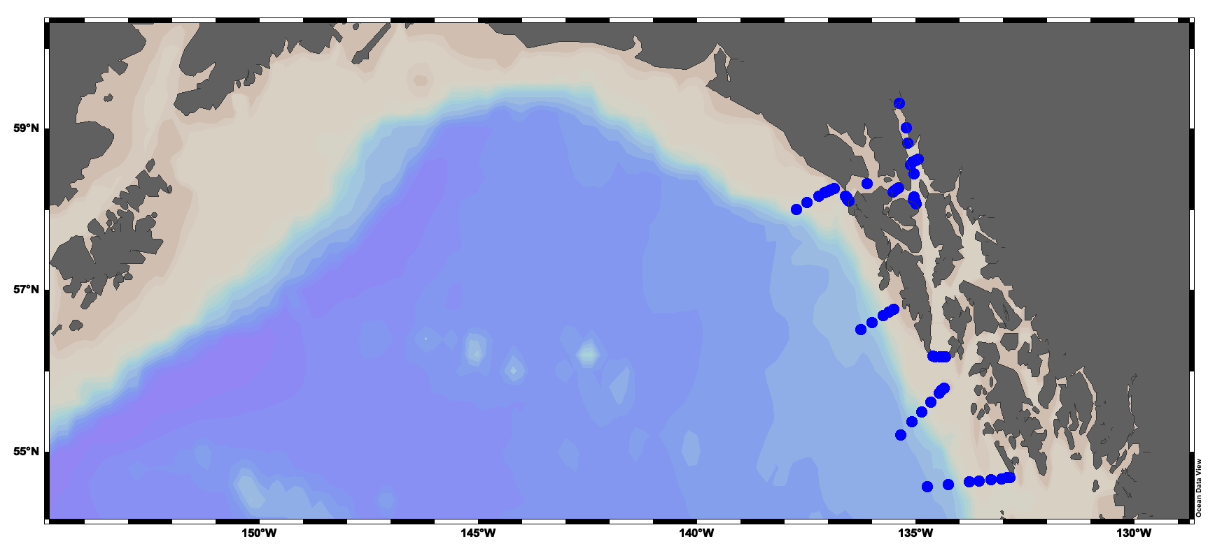
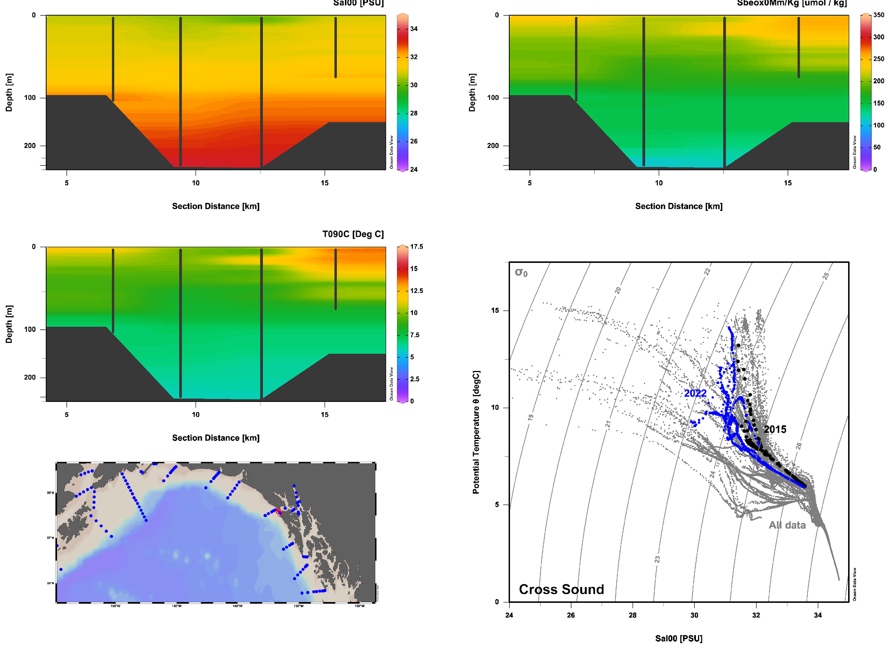
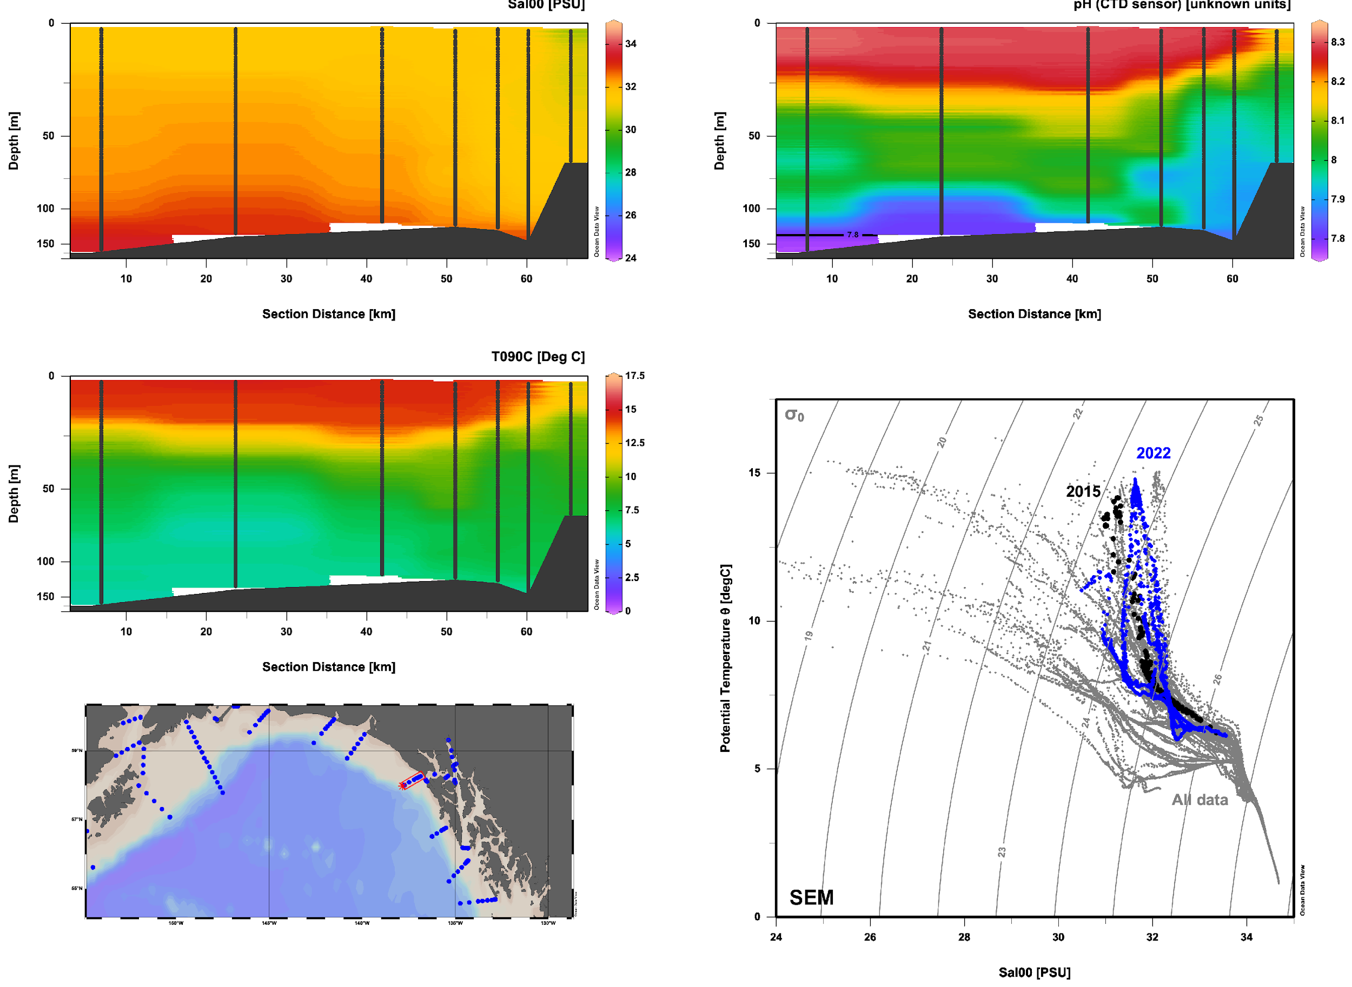
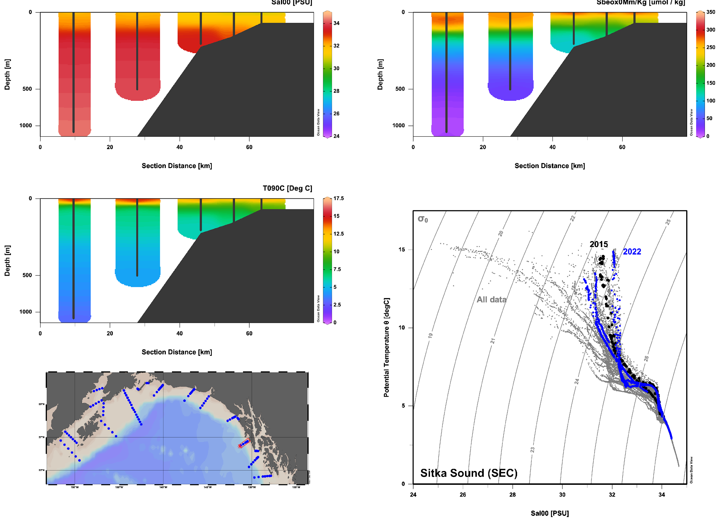
Water masses 2015 vs 2022 SEC and SEM both have diverging domains: warmer / saltier offshore but cooler / fresher by the coast
SEM
XS
SEC

Slide 3
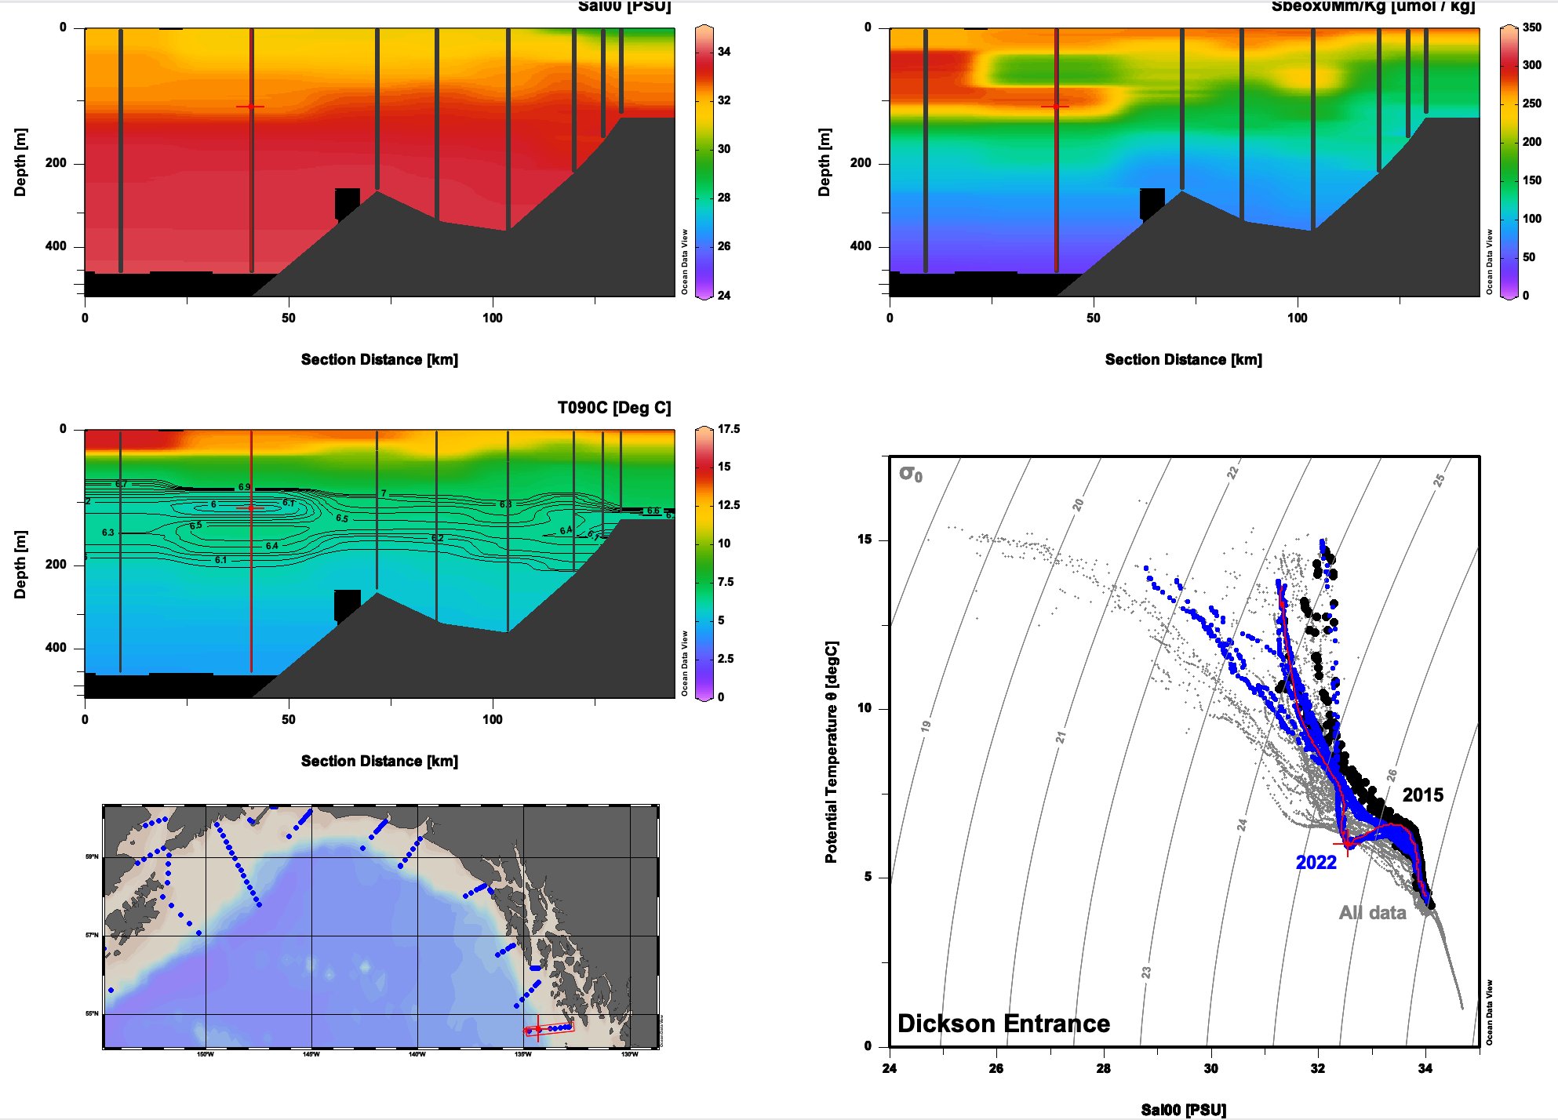
2022 Notable Features Dickson Entrance: eddy??

Slide 4
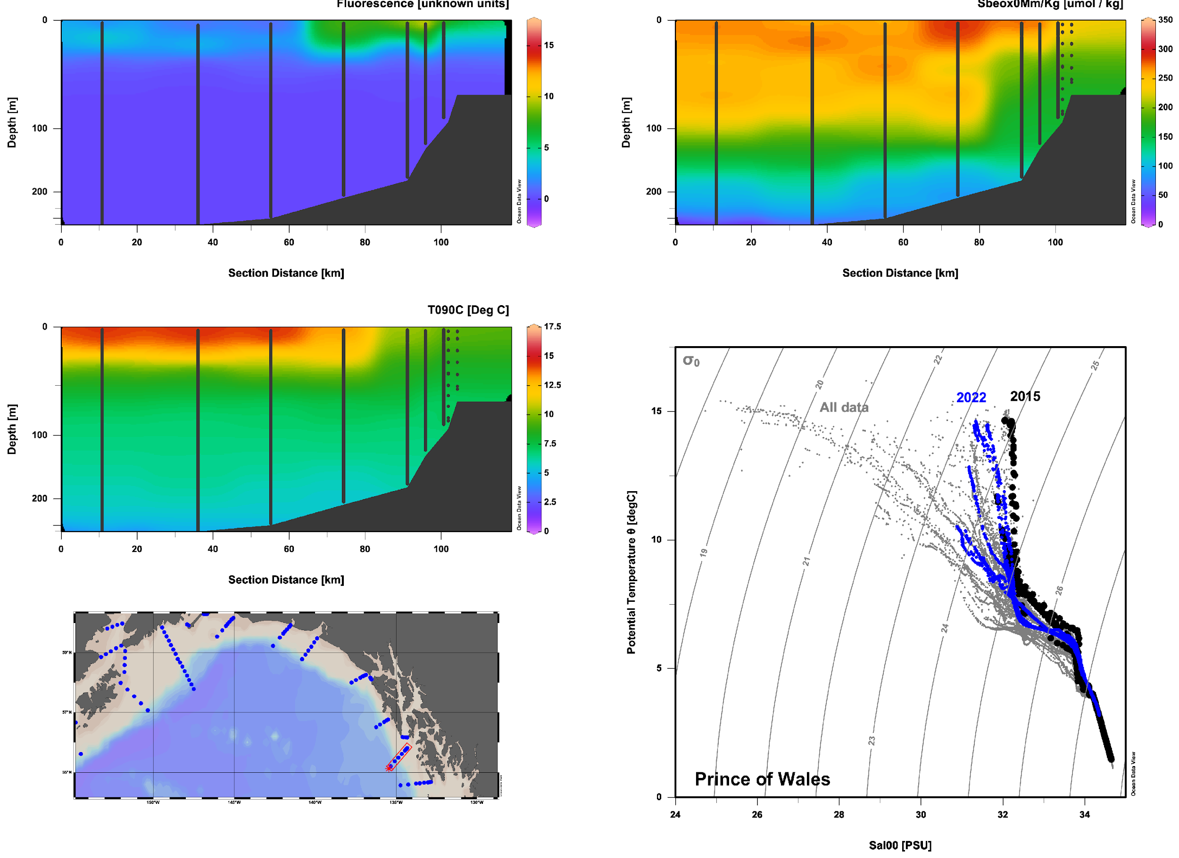
2022 Notable Features POW: Frontal productivity peak

Slide 5
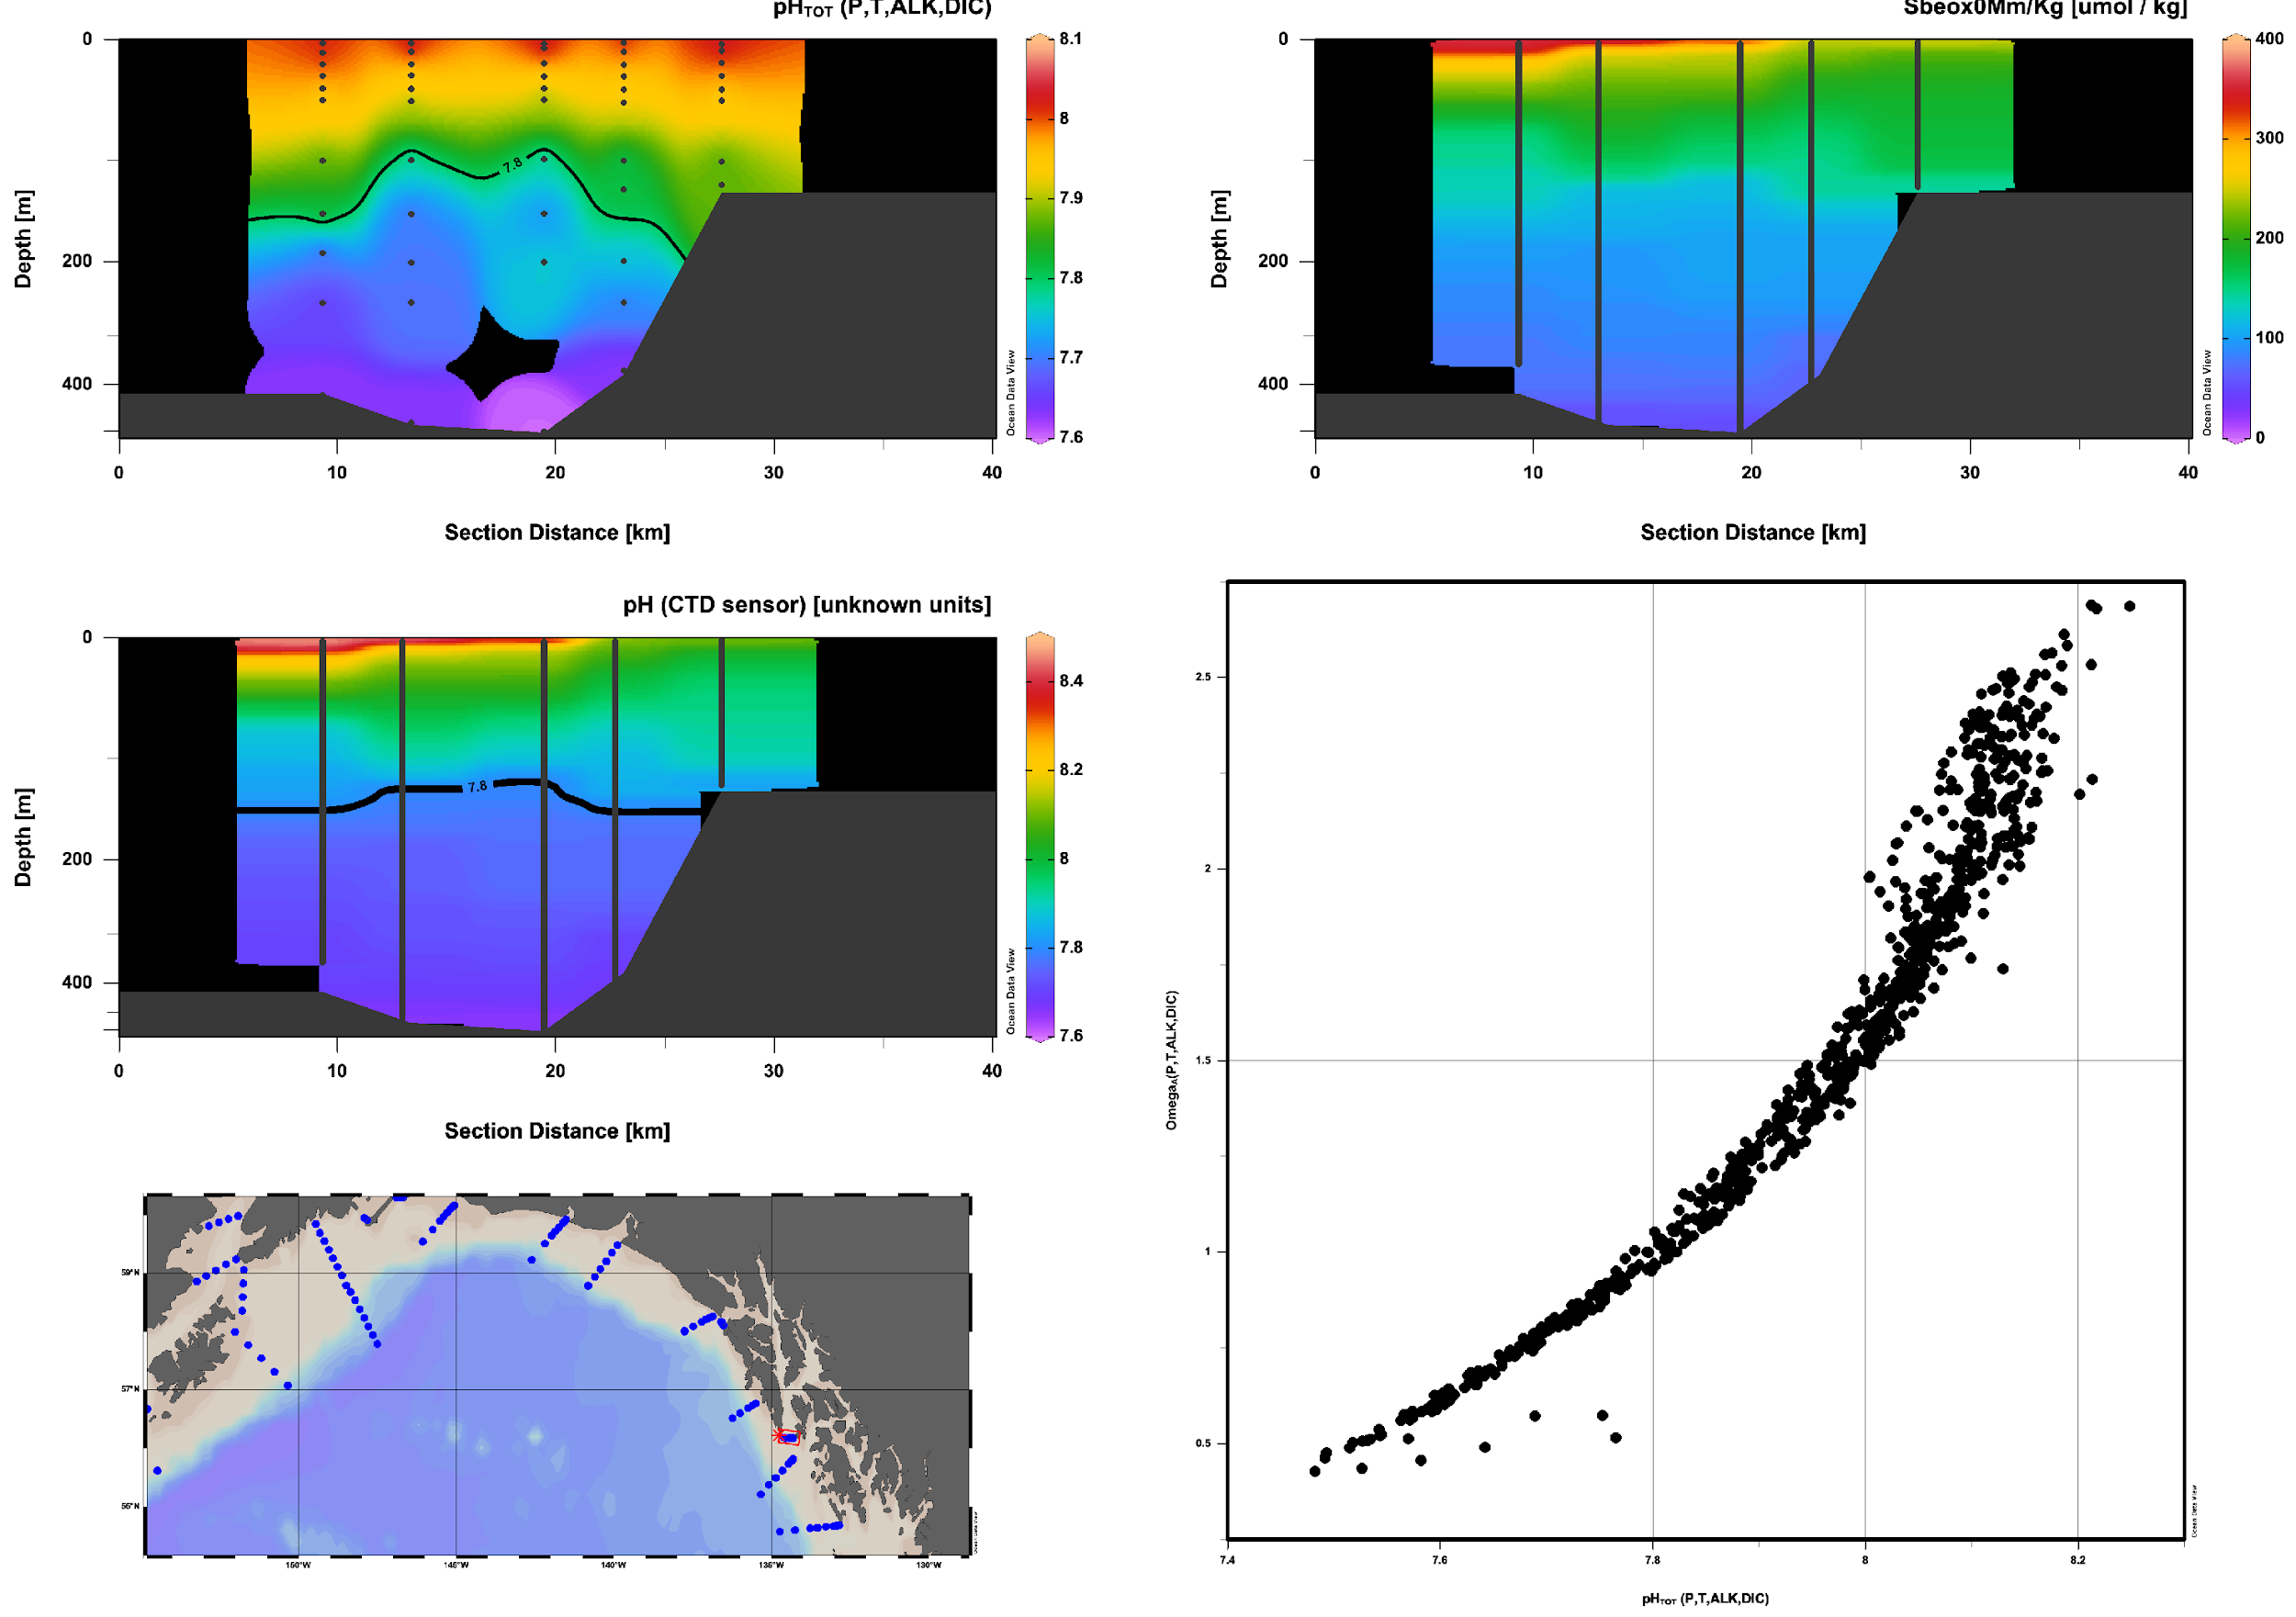
2022 Notable Features Chatham Strait:
Corrosive water
2015
2022
2015
2022
Shee ya xhaak in the Tlingit language
Shee, Baranof Island; Ya, face; Xhaak, Center.
7.8 pH = 1 Omega

Slide 6
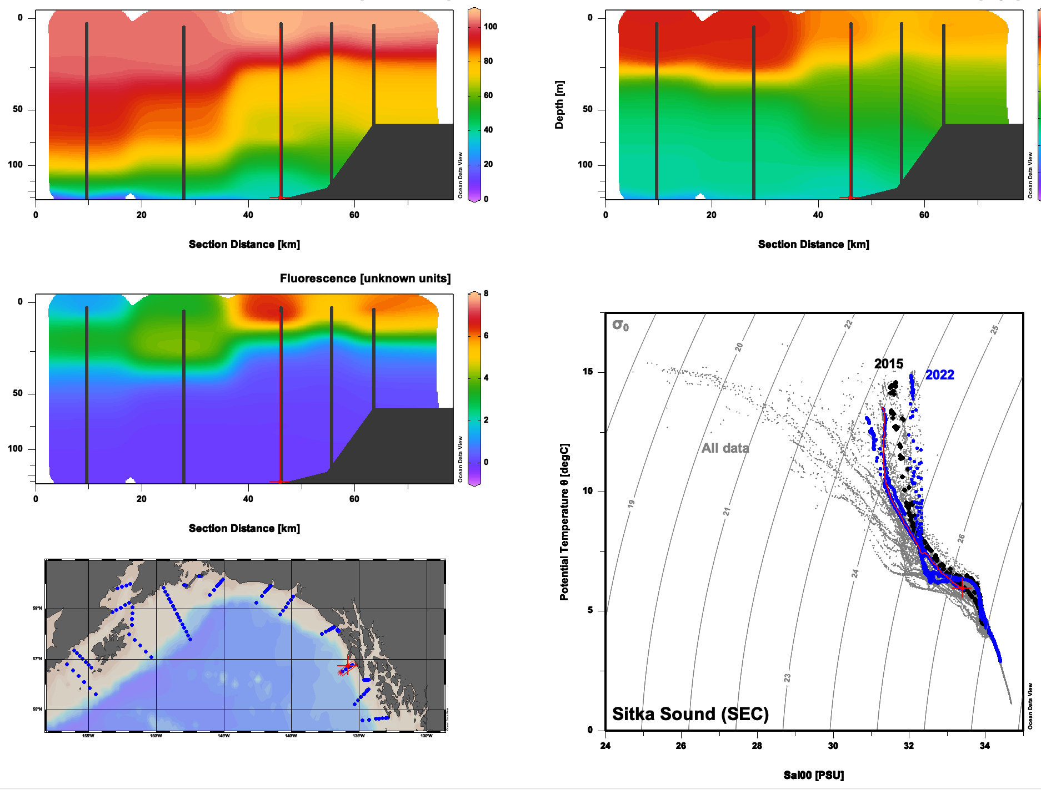
2022 Notable Features SEC: Diverging domains

Slide 7
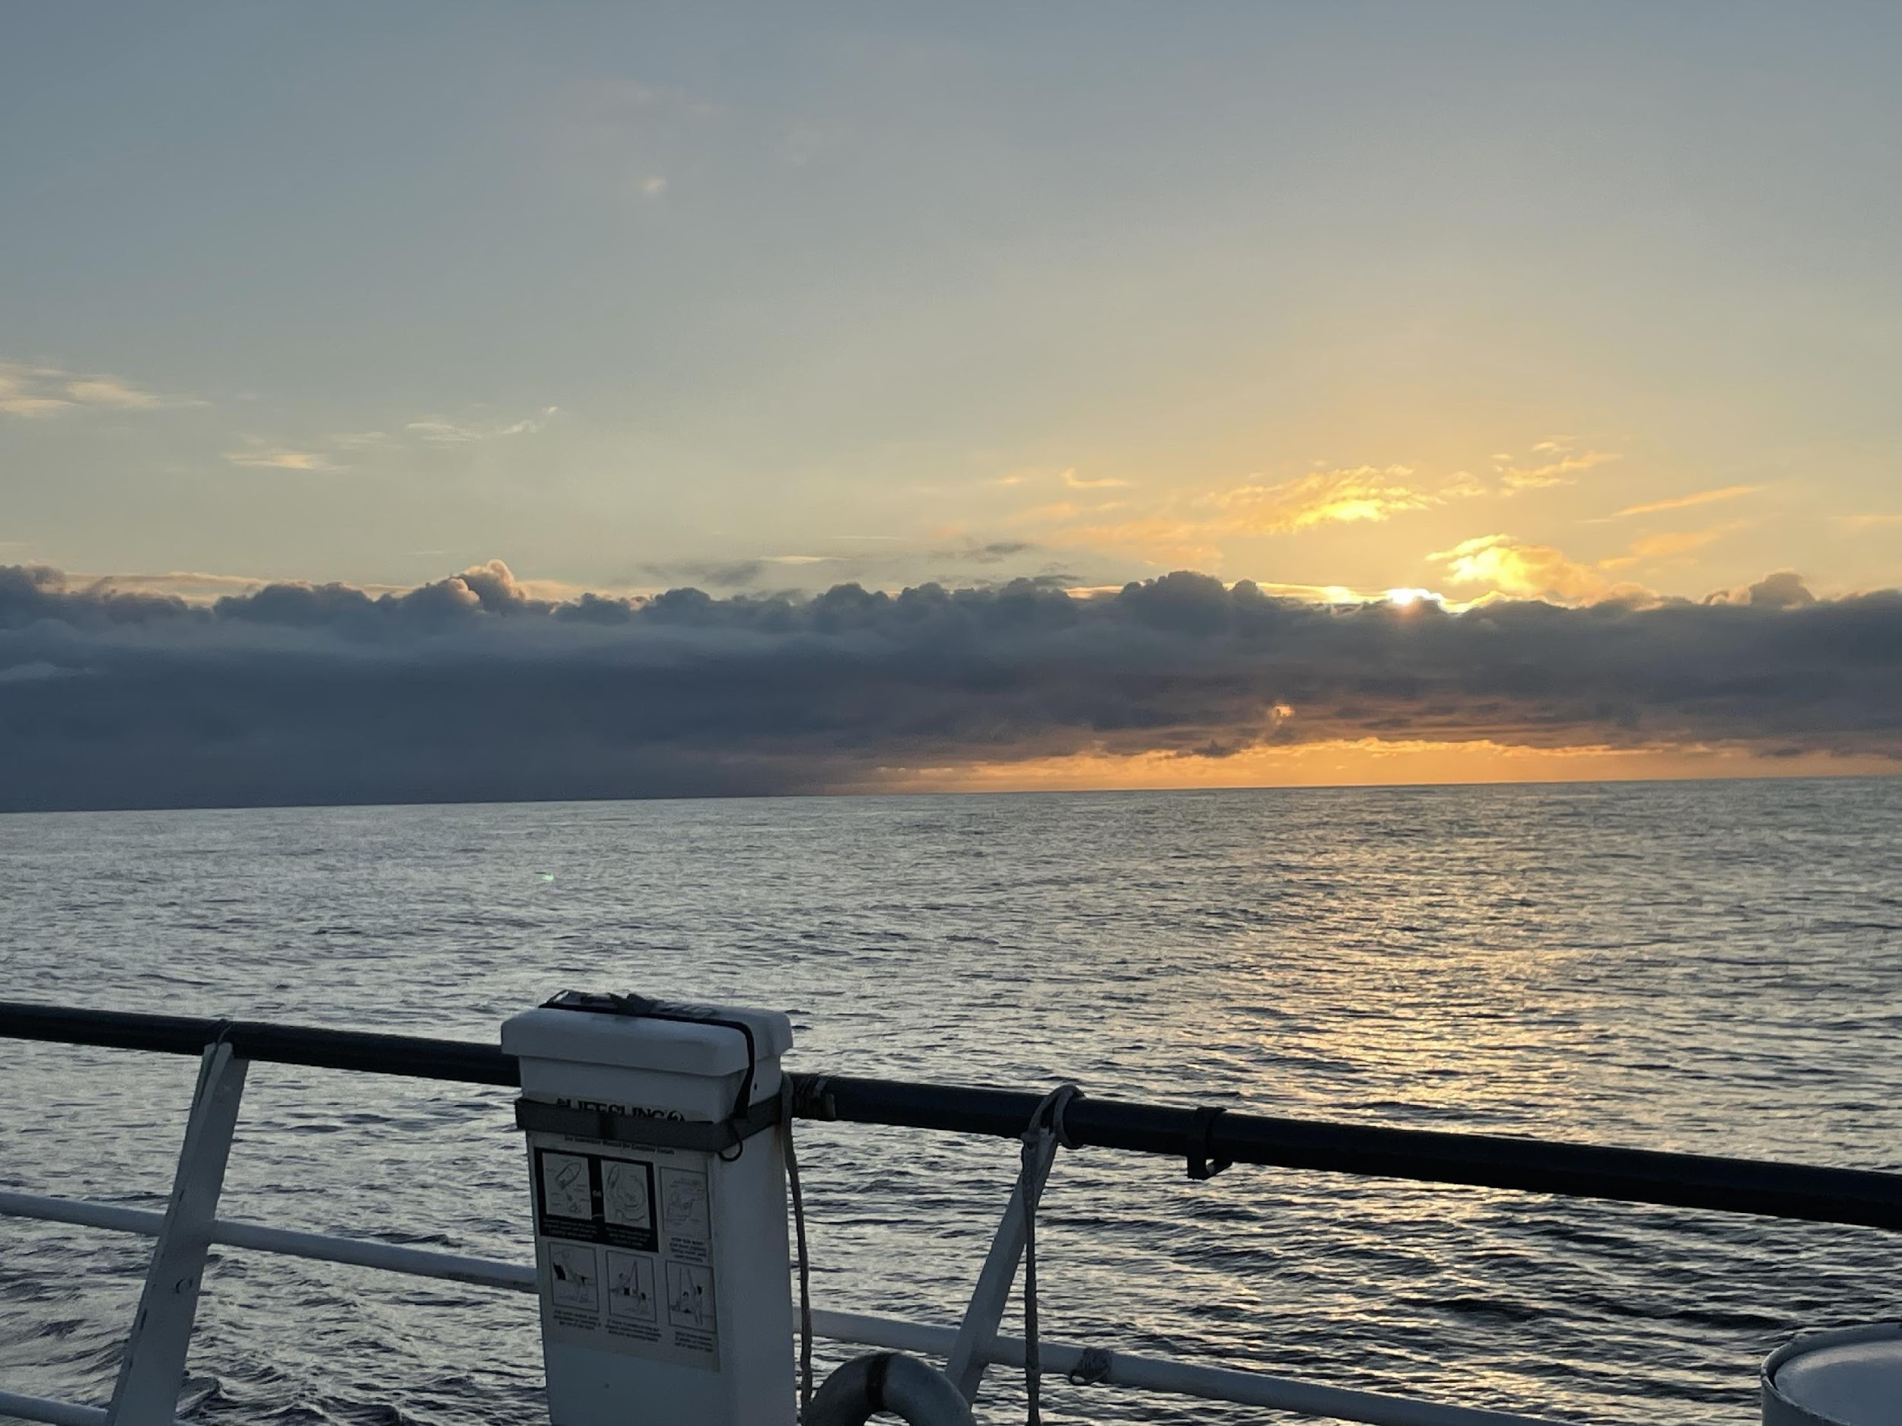
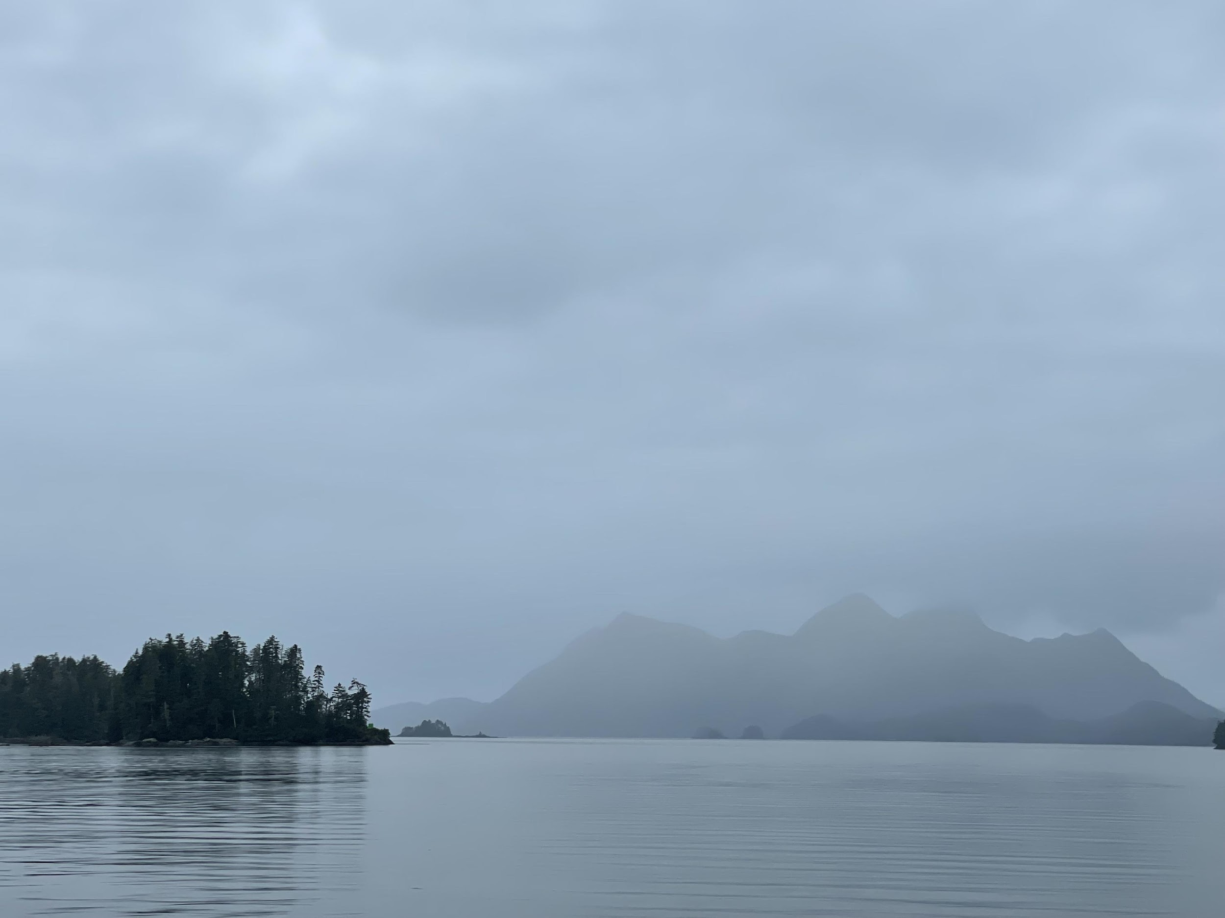
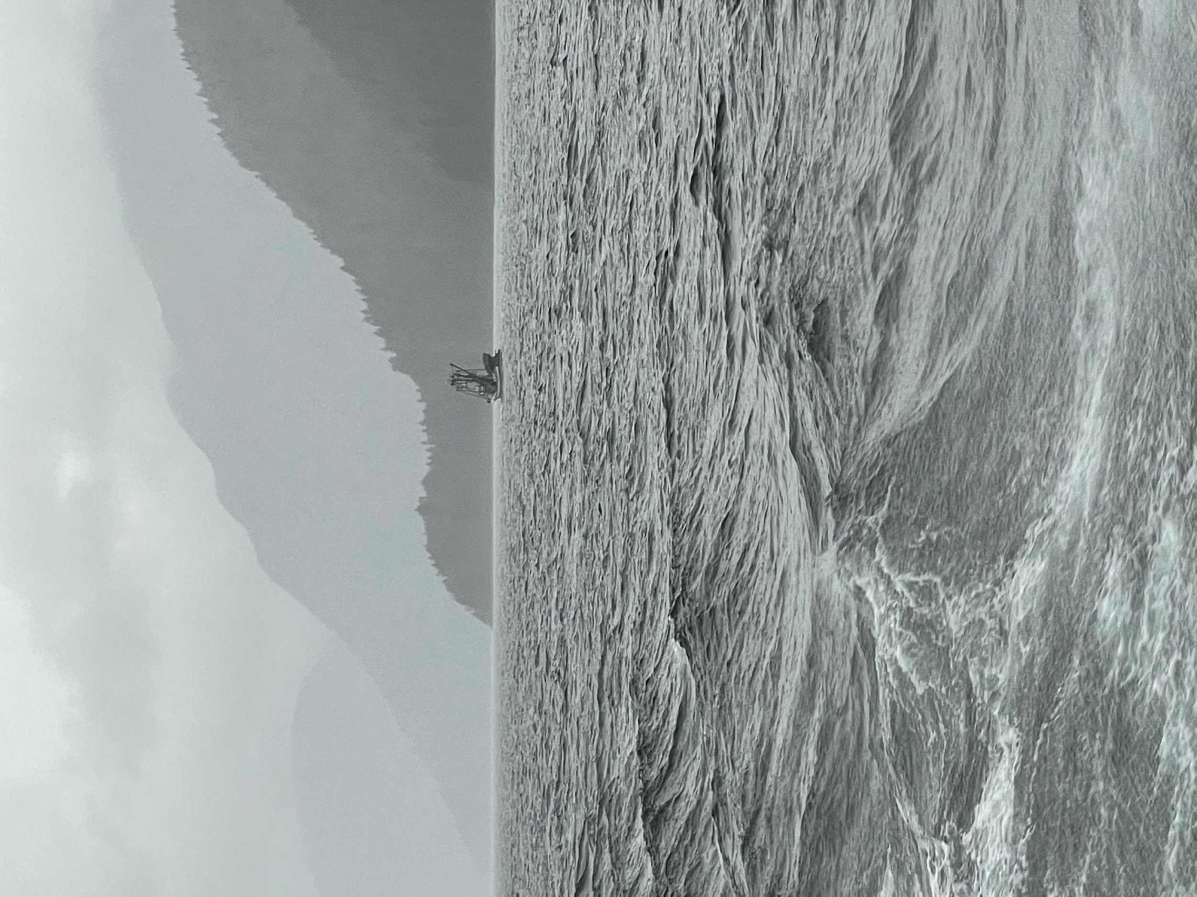
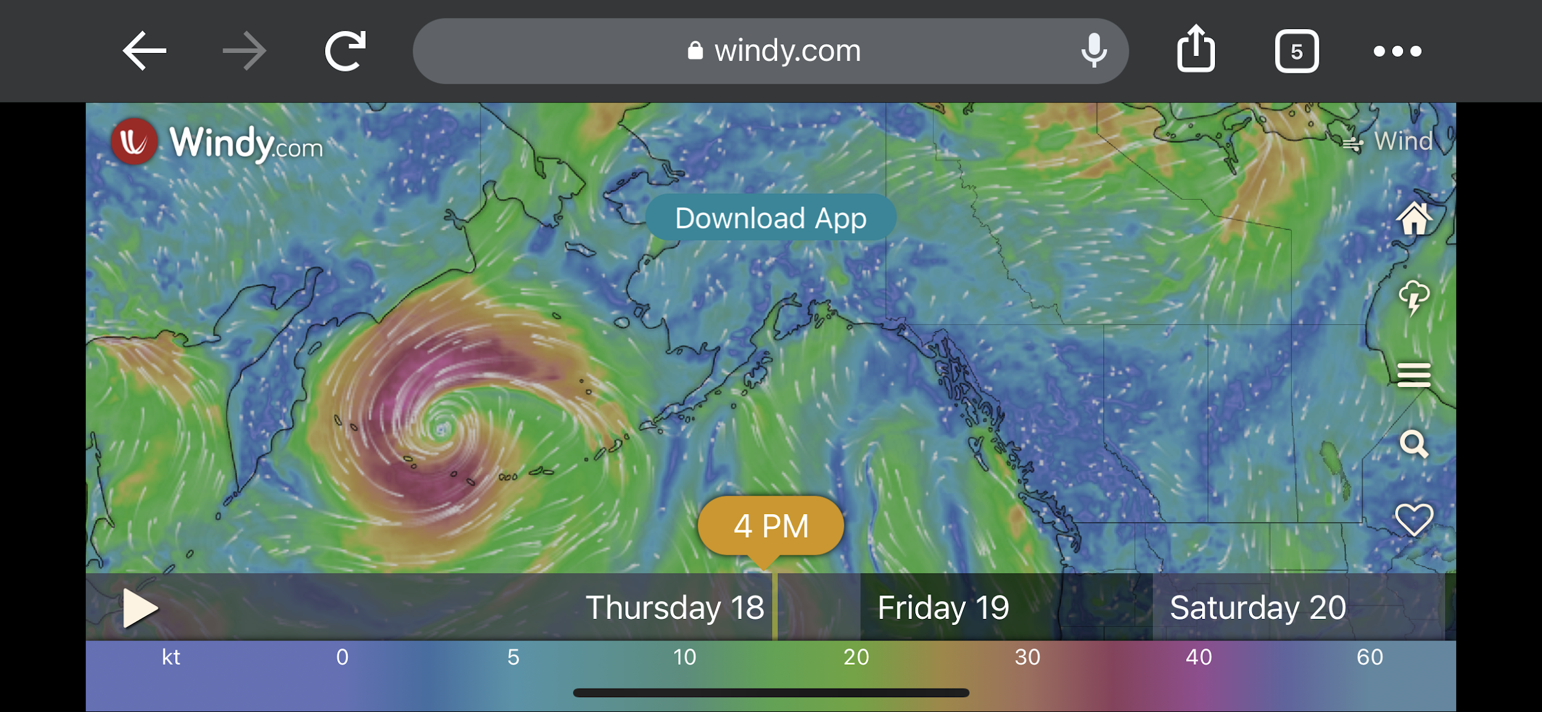
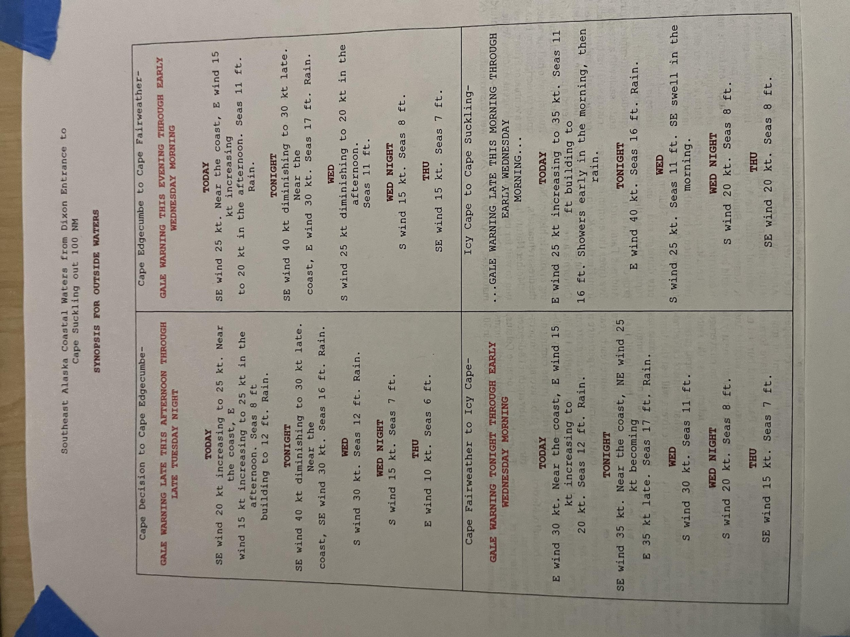
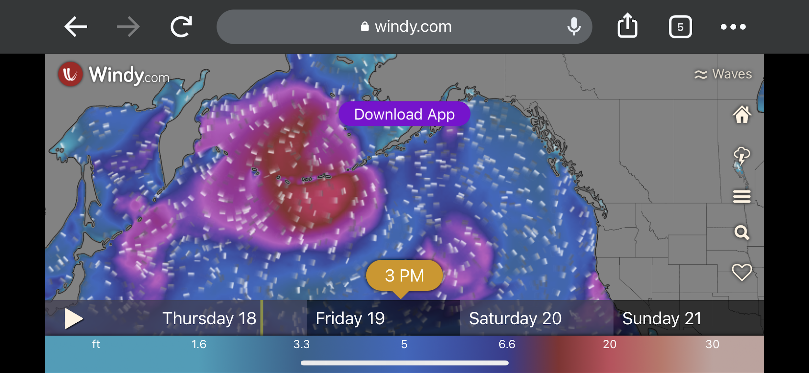
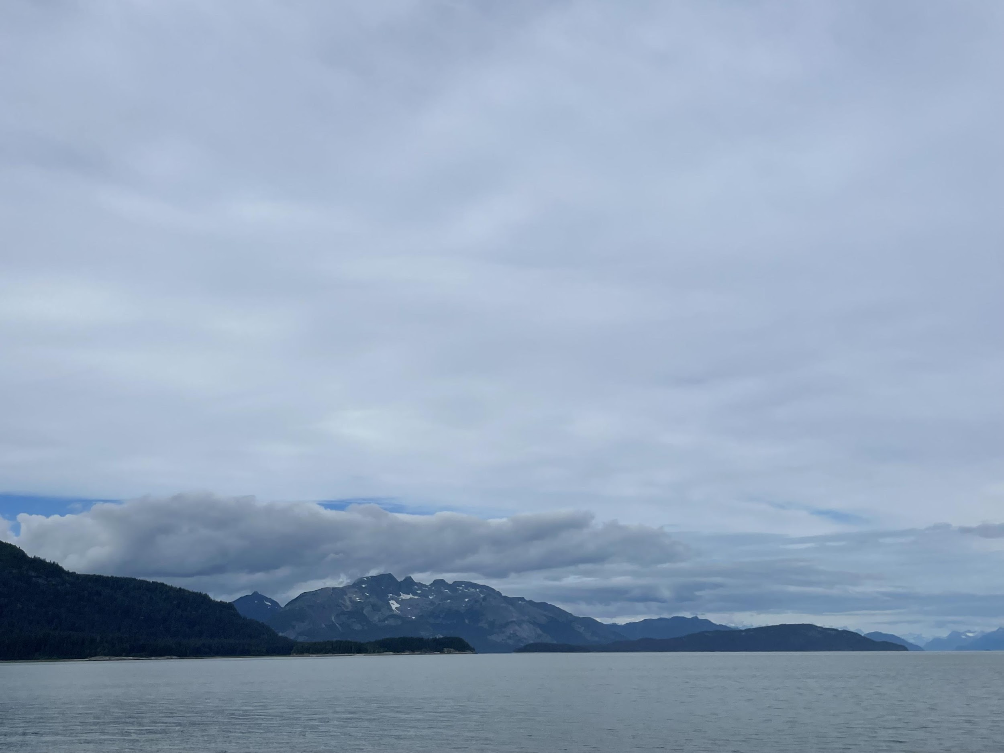
2022 Notable Features The weather picked up
Advancing cloud bank, SEM line, Sunday evening August 14
Fog / Rain in Lynn Canal, Tuesday midday August 16
Wind Chop in Lynn Canal, Tuesday evening August 16; 50 kt gales blowing spray in our face
We (think) we made a good call: don’t have internet but look at this storm trying to push its way over the mountains, Friday Aug 19
Gale warnings and small craft advisory for offshore through Wednesday evening August 17; seastates forecast to remain high through Thursday August 18. Despite high sea states, we do a test run with two nearby offshore lines to see what it feels like
We decide not to risk this monstrosity moving SE faster than forecast or pushing high seastates into the C gulf; there’s nowhere to hide and all parties are uncomfortable. We go to GB instead

Slide 8
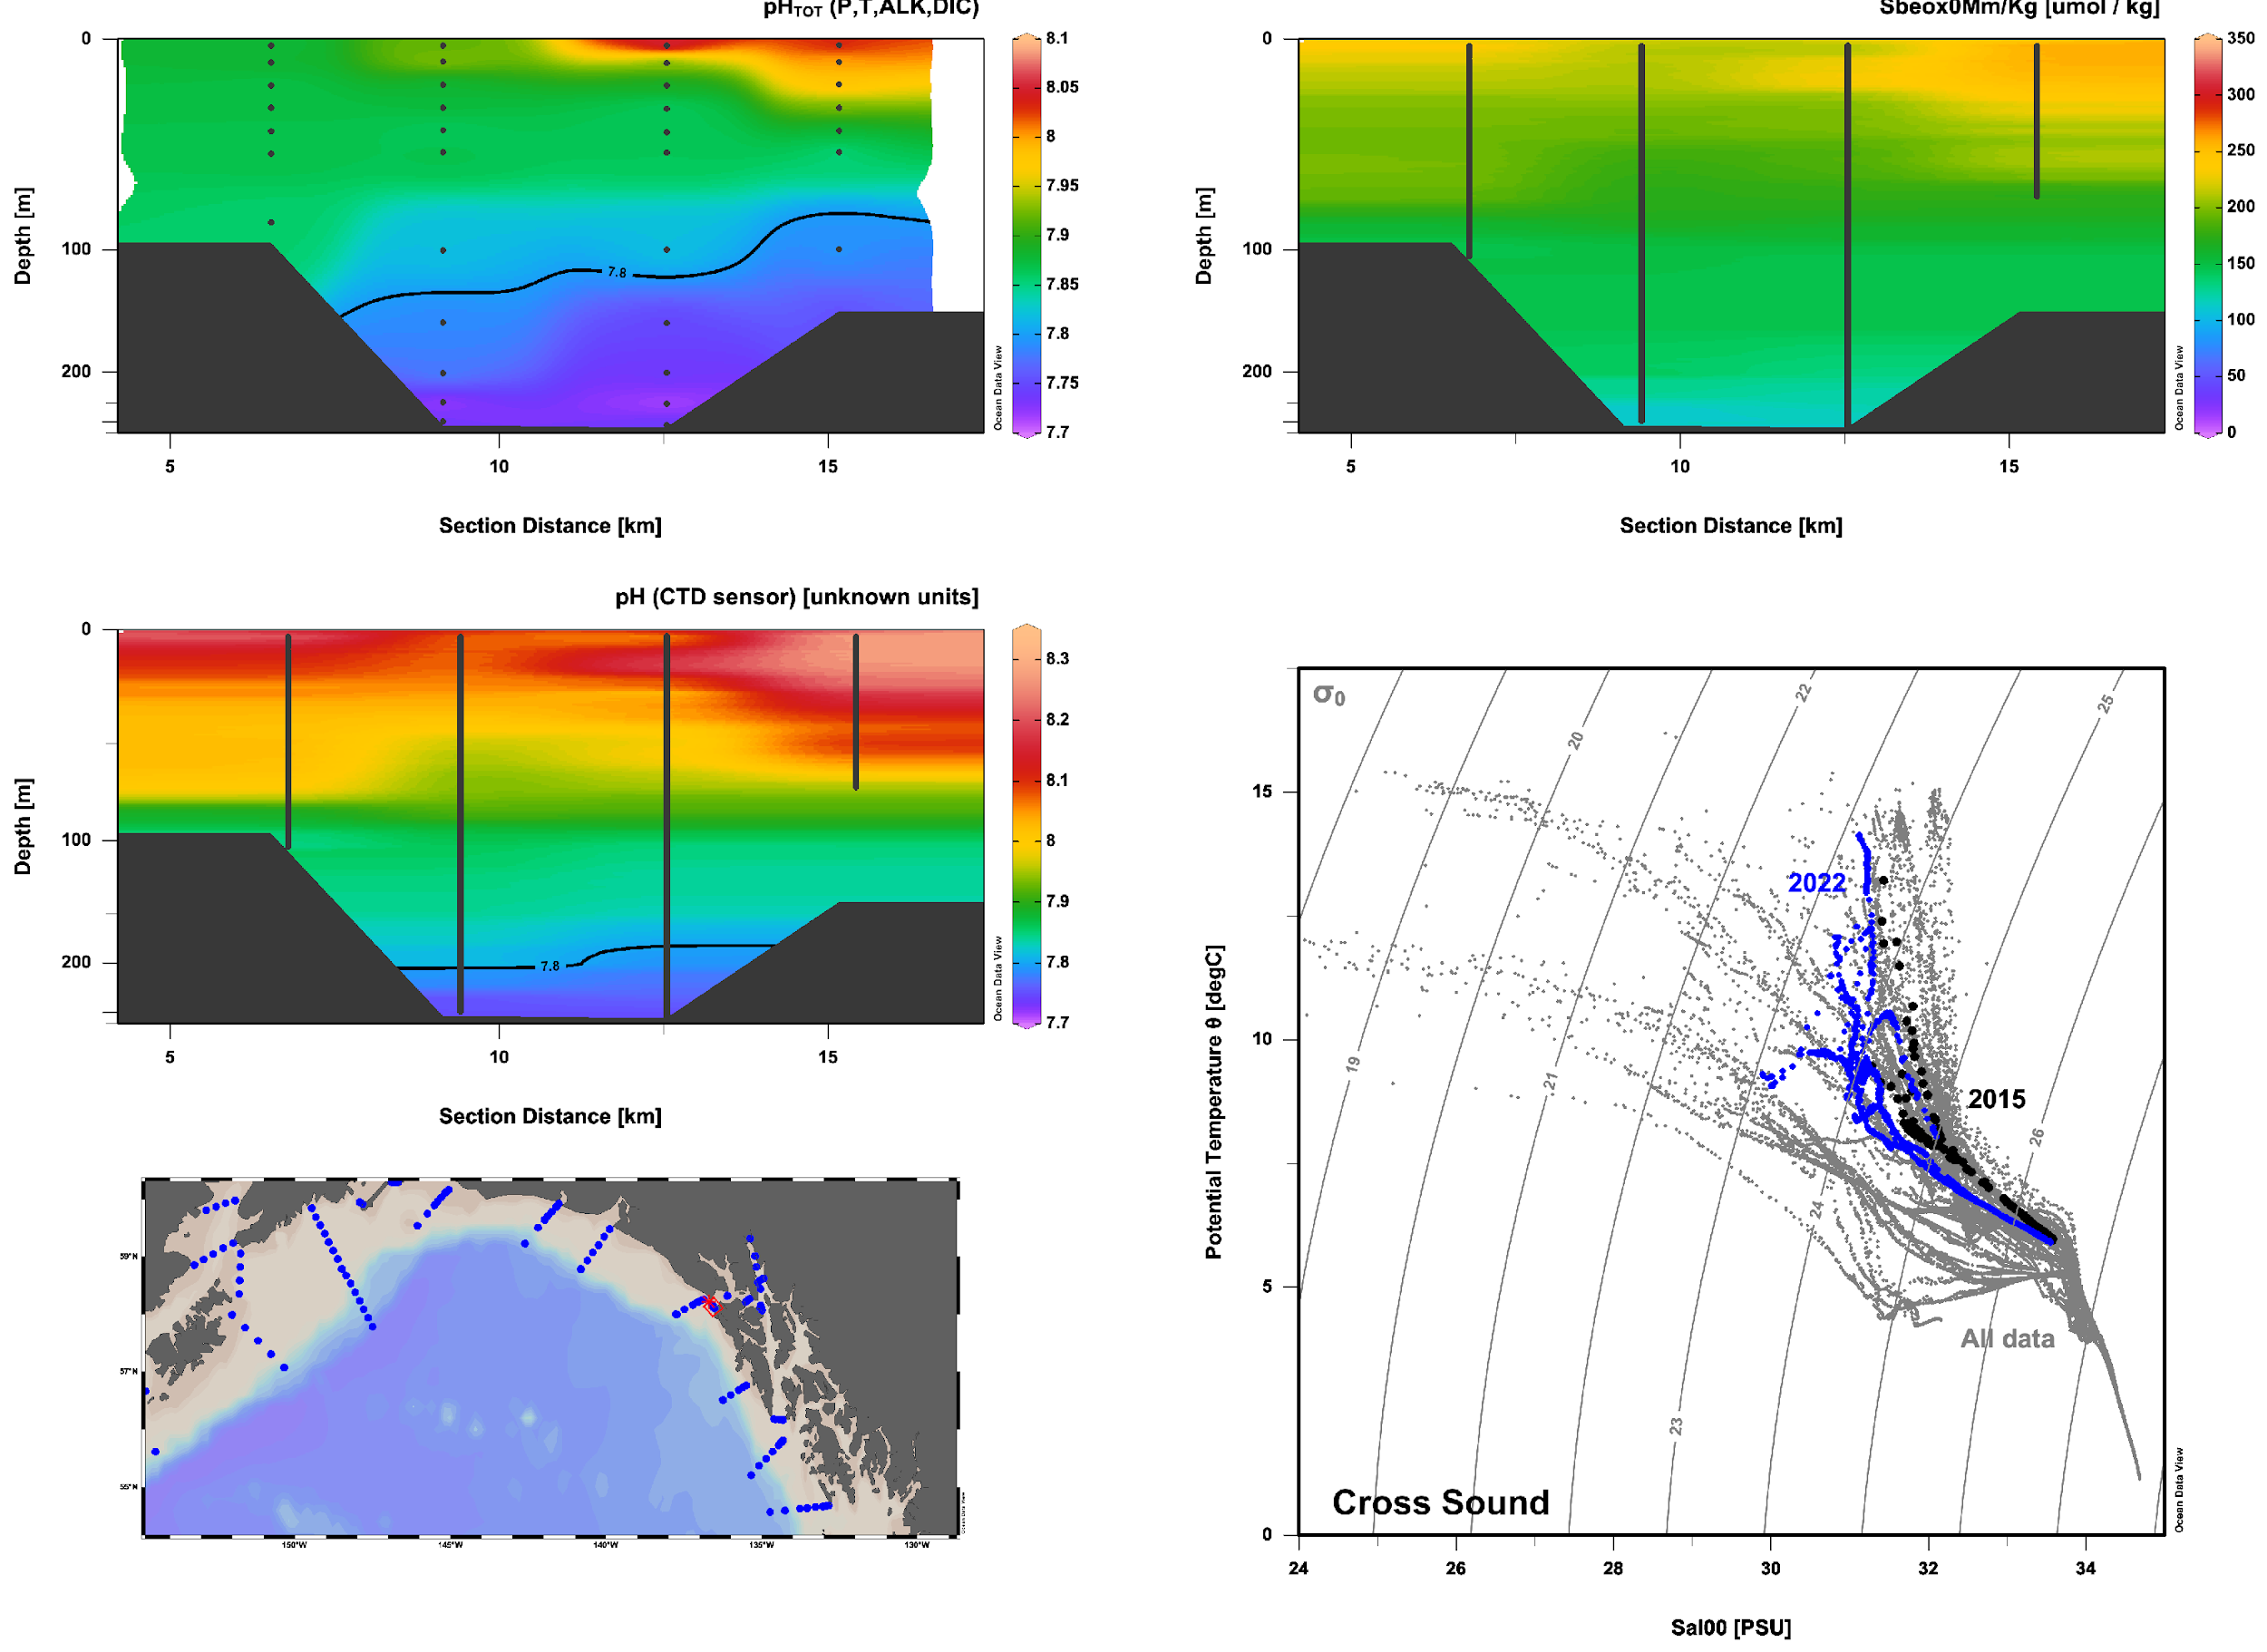
2022 Notable Features Cross Sound: less corrosive water at the entrance
2015
2022
2022

Slide 9

2022 Notable Features SEM: Diverging domains: warmer surface; fresher nearshore; saltier bottom water. Low lens of corrosive water at bottom.

Slide 10
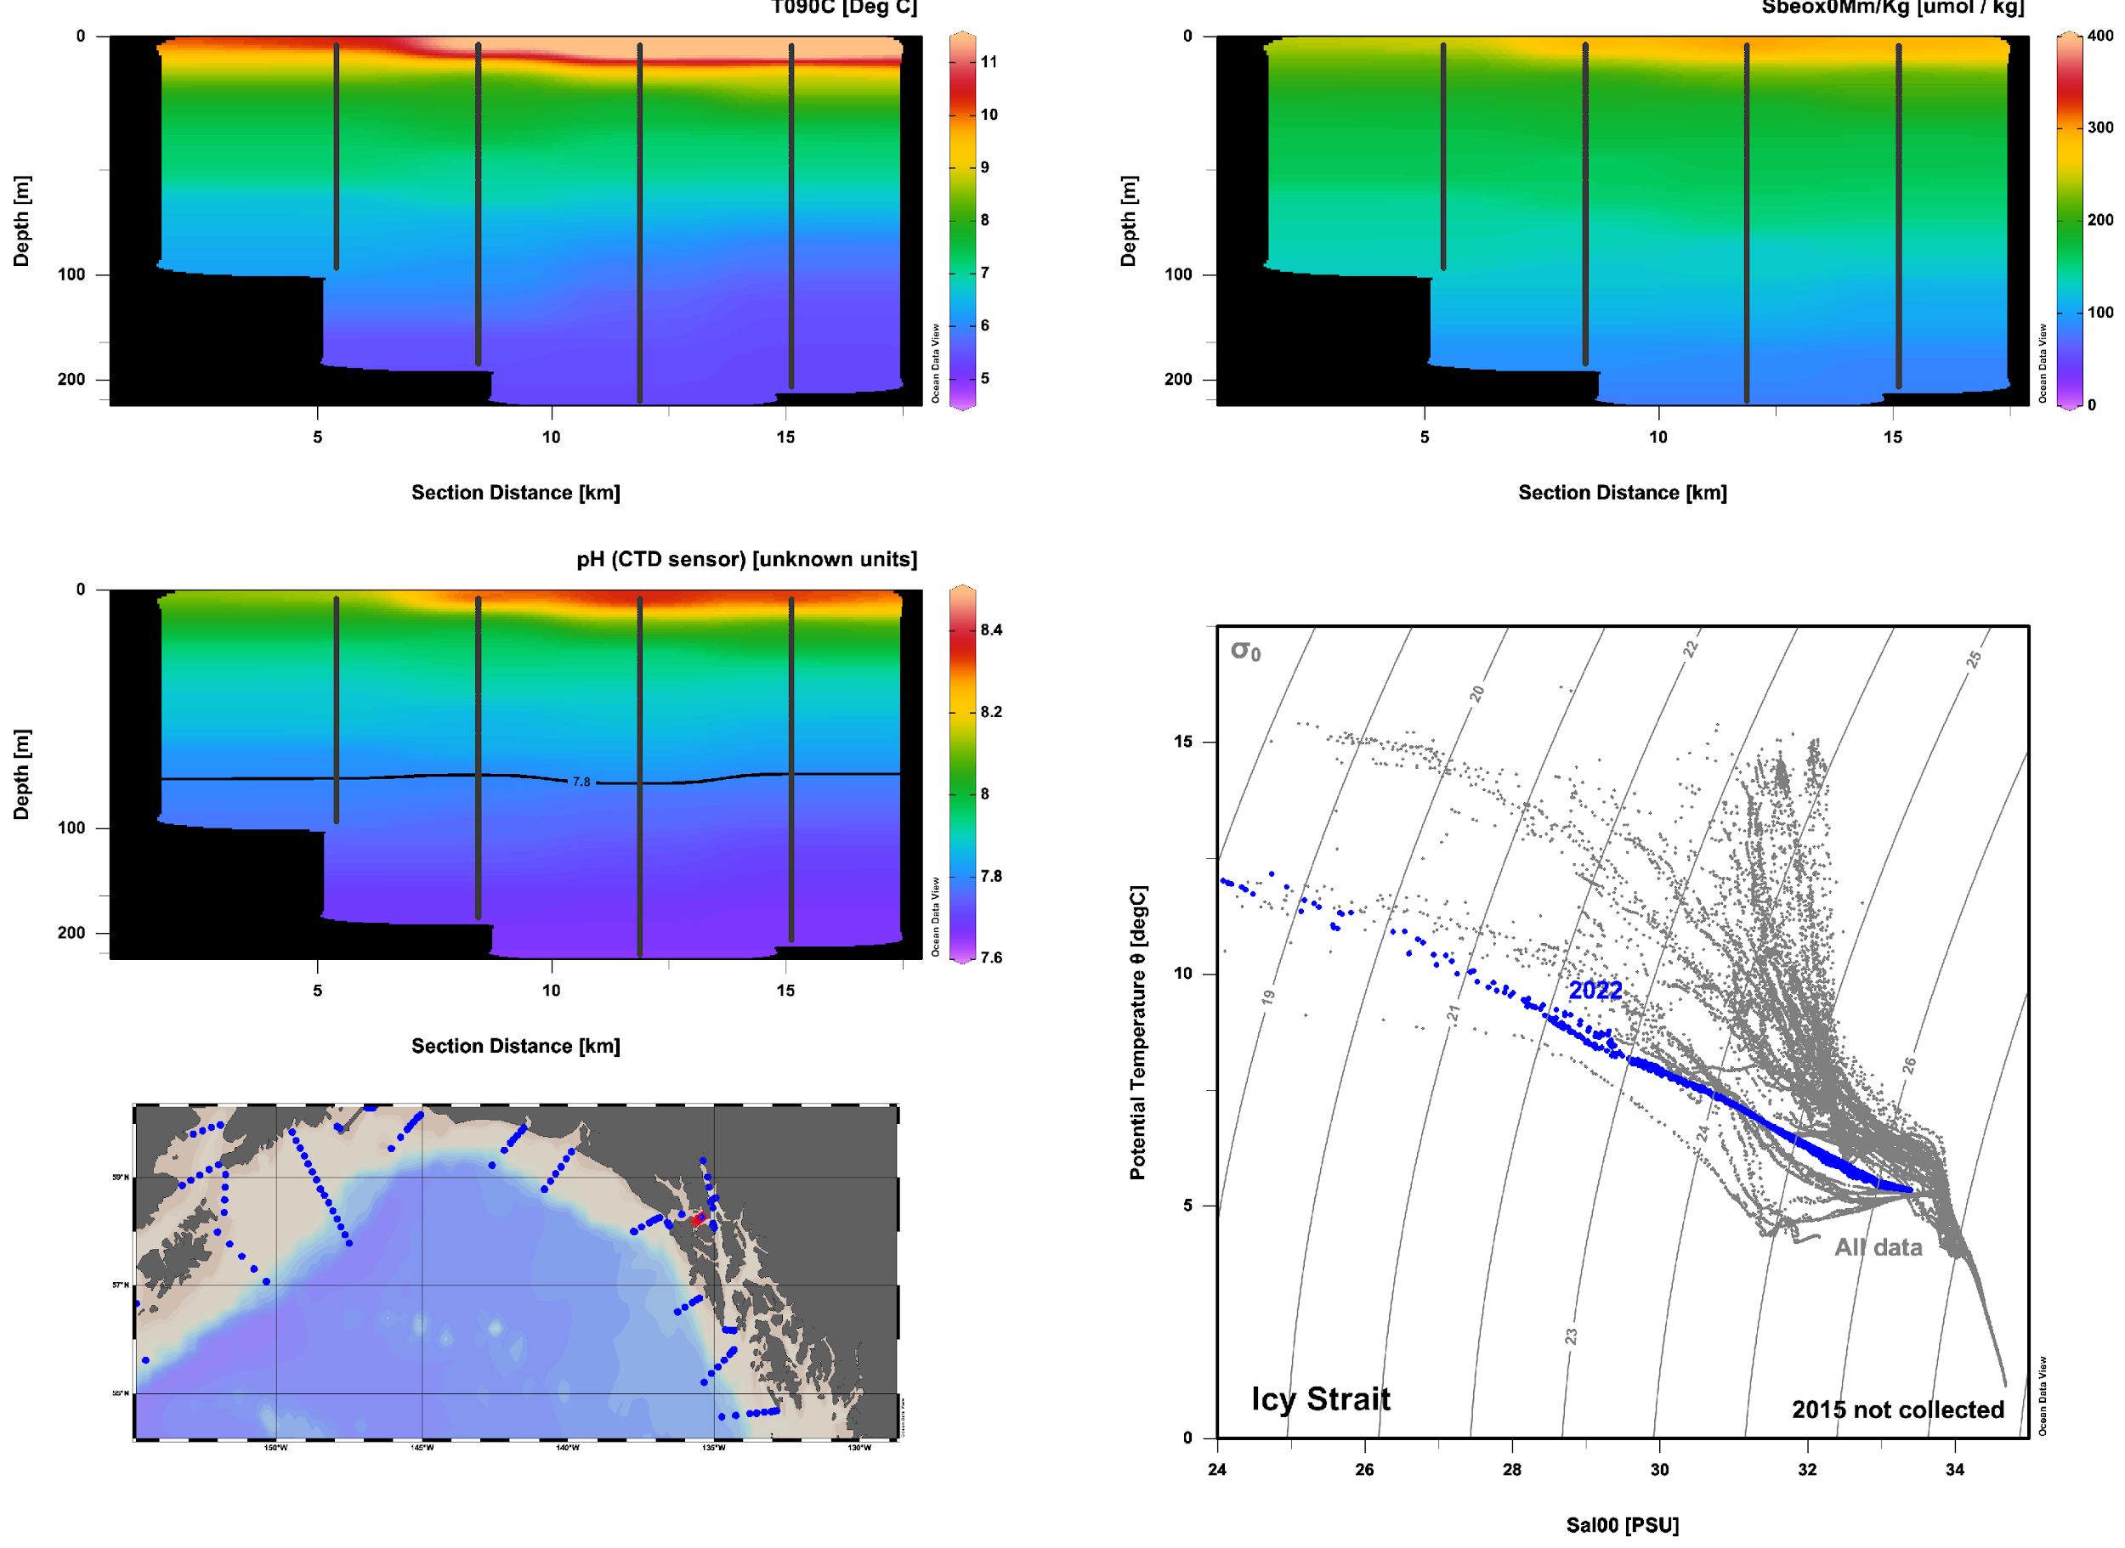
2022 Notable Features Icy Strait: If the corrosive water is not coming in at Cross Sound, where is it coming from?

Slide 11
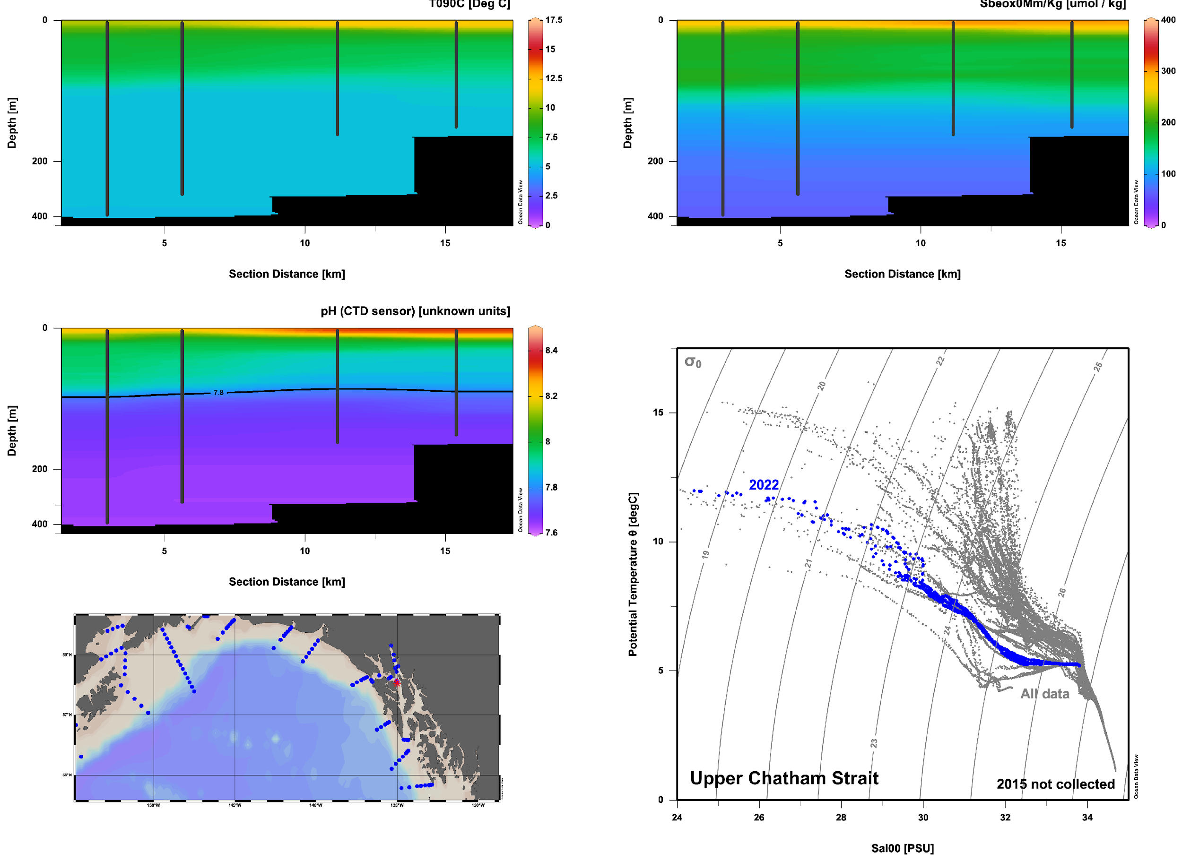
2022 Notable Features Upper Chatham Strait:
Looks like its coming up Chatham Strait

Slide 12
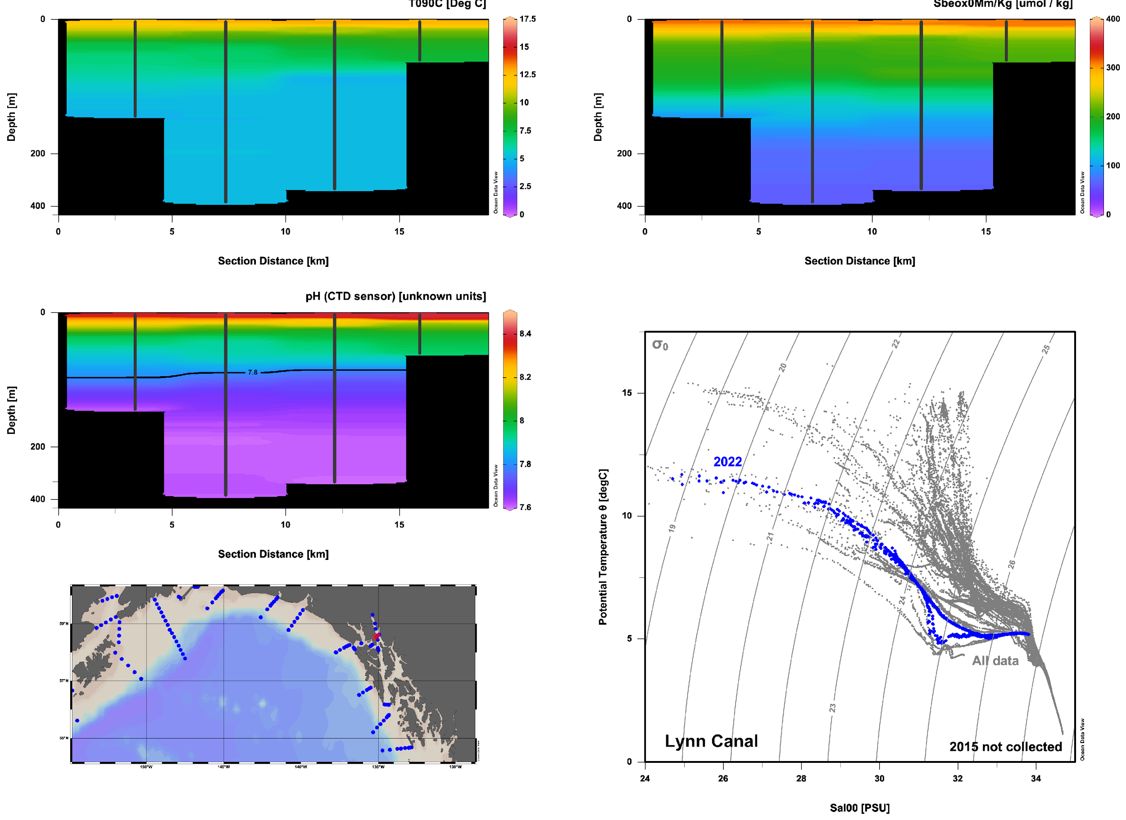
2022 Notable Features Lynn Canal EW:
Low pH water coming up Chatham into Lynn Canal... How far does it go?

Slide 13
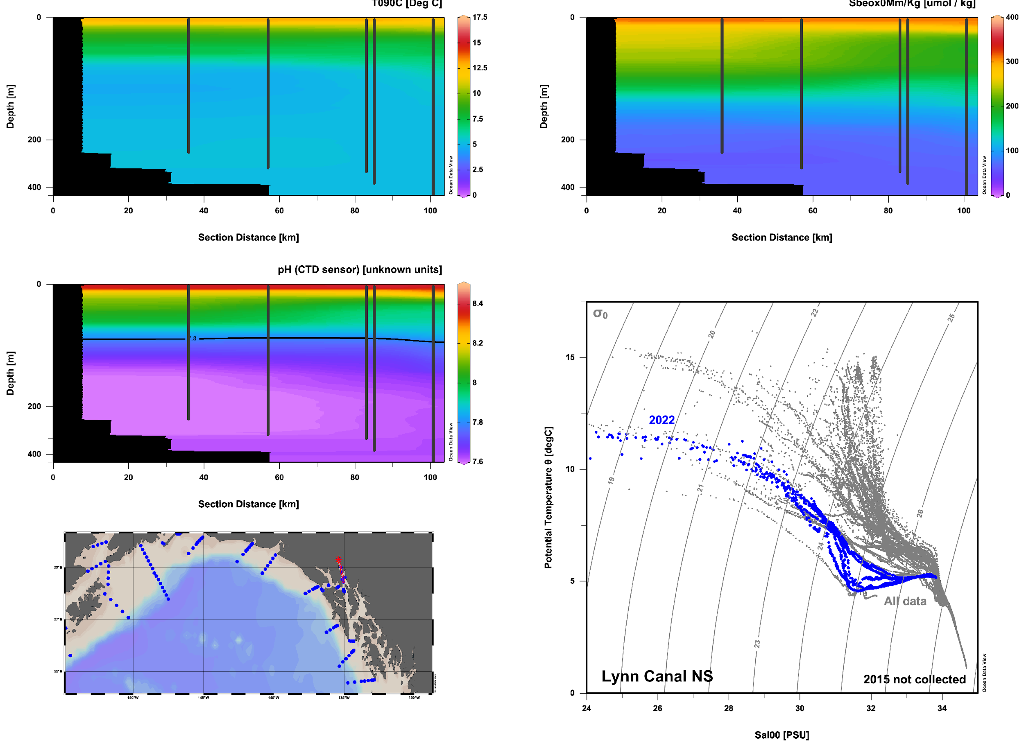
2022 Notable Features Lynn Canal NS:
Low pH water coming up Chatham and charging into Lynn Canal... It goes all the way to Skagway
Sampling during 50 kt winds and a small craft advisory

Slide 14
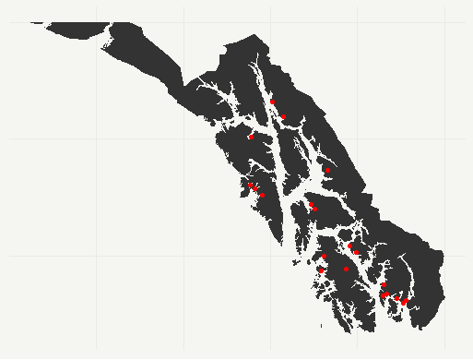
2022 Notable Features Lynn Canal NS:
Low pH water coming up Chatham and charging into Lynn Canal... It goes all the way to Skagway
This is home to aquaculture leases
Will sample lower Chatham, Stephens passage, Frederick Sound if weather remains bad

Slide 15
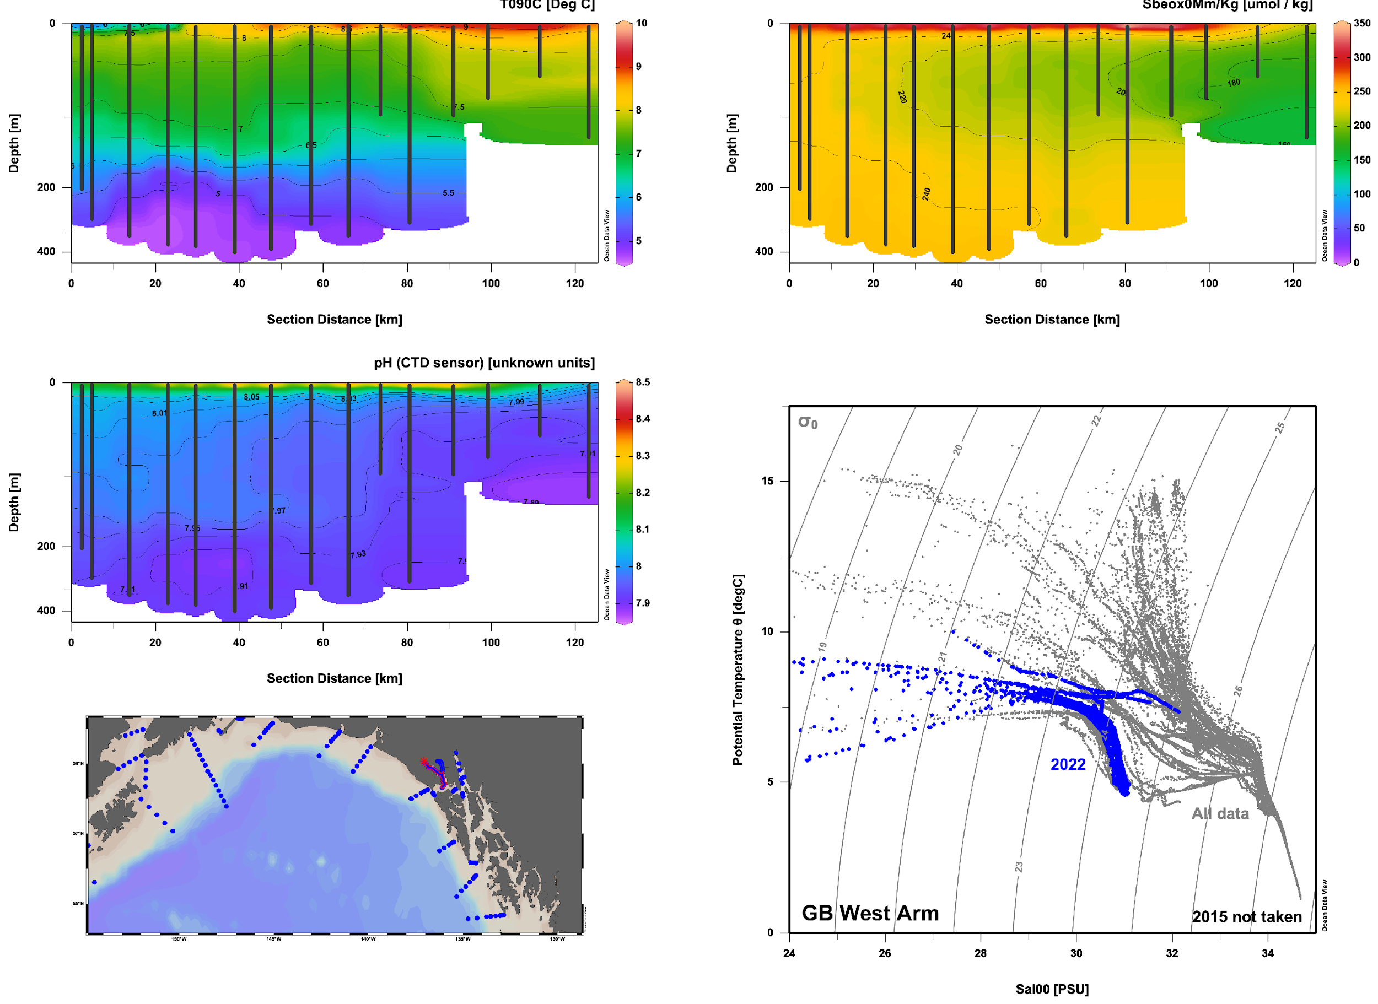
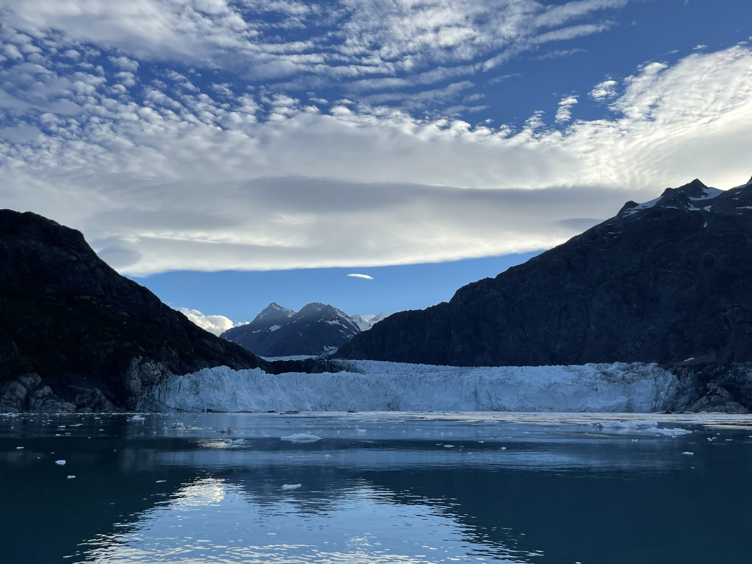
2022 Notable Features Glacier Bay West Arm
Tidewater glacial input

Slide 16
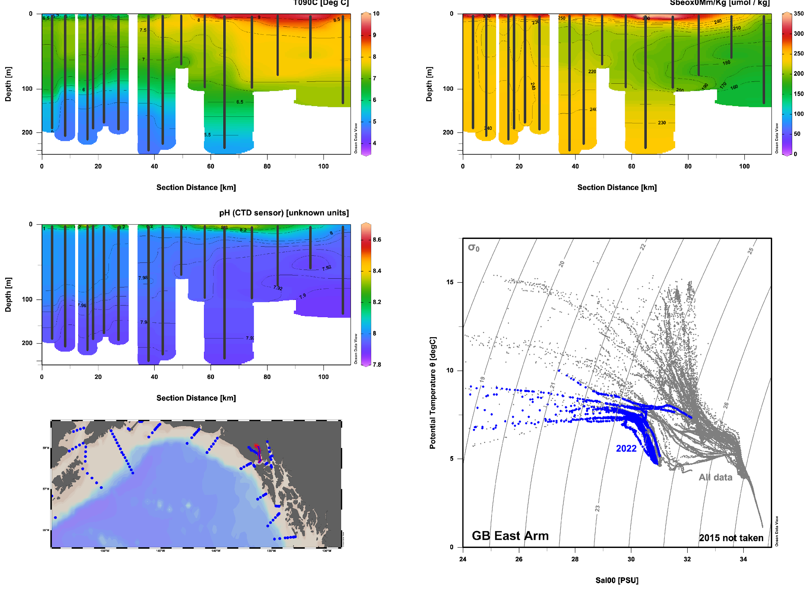
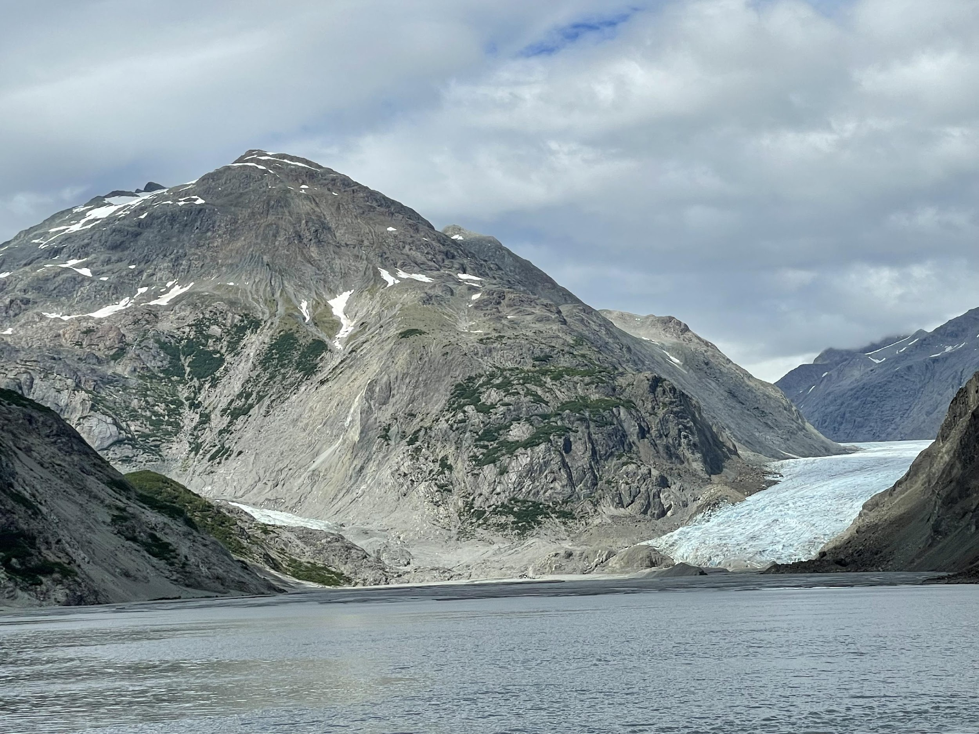
2022 Notable Features Glacier Bay East Arm
No longer tidewater

Slide 17
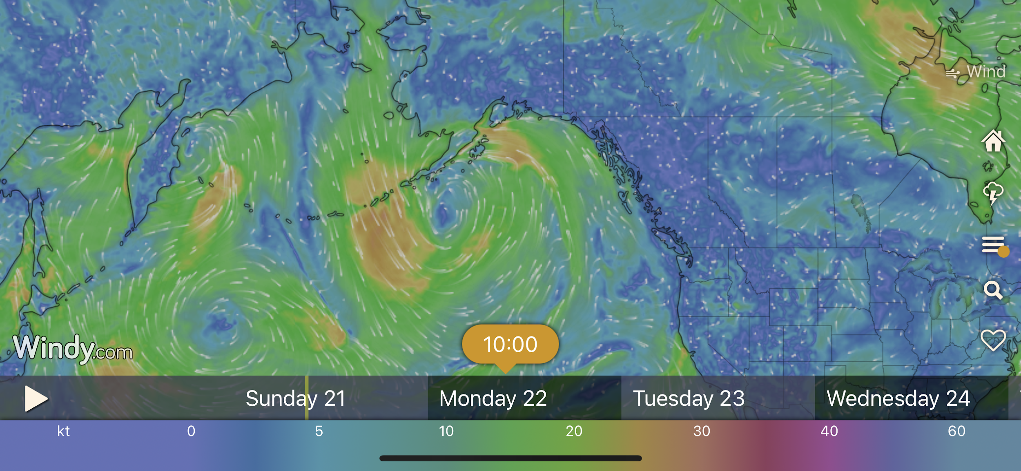
2022 Notable Features Weather update
As expected, cyclonic system moved east into our path in the central gulf; headed to Stephen’s Passage

Slide 18
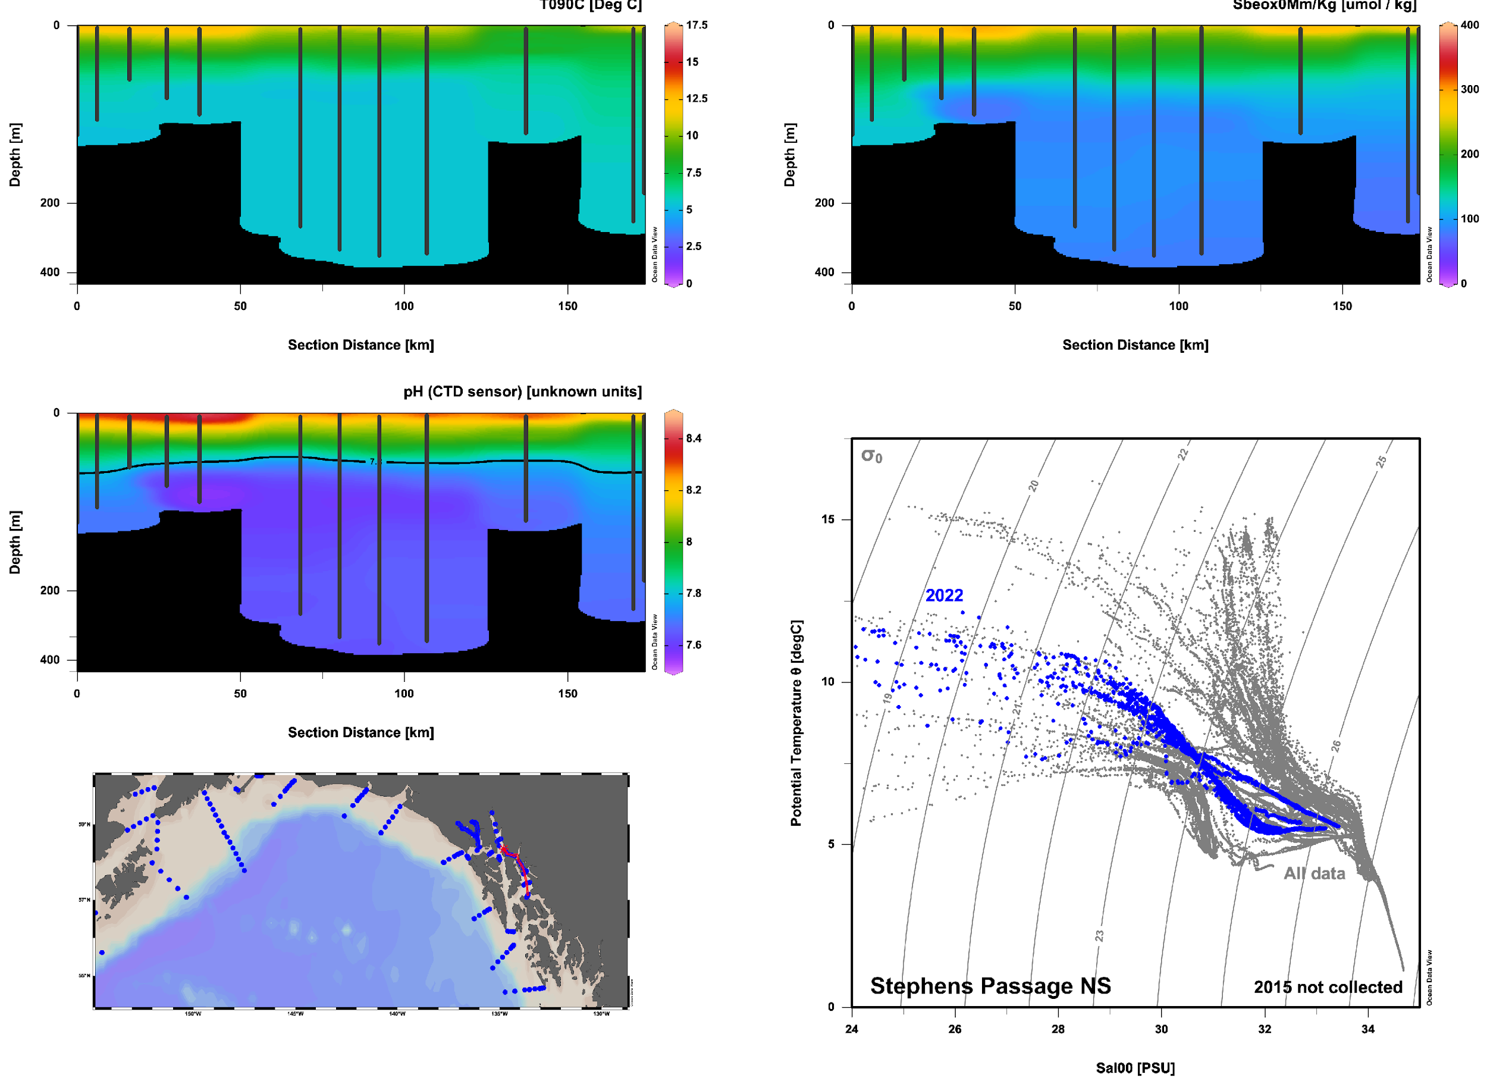
2022 Notable Features Stephens Passage N/S:
Classic biological pump at N end

Slide 19
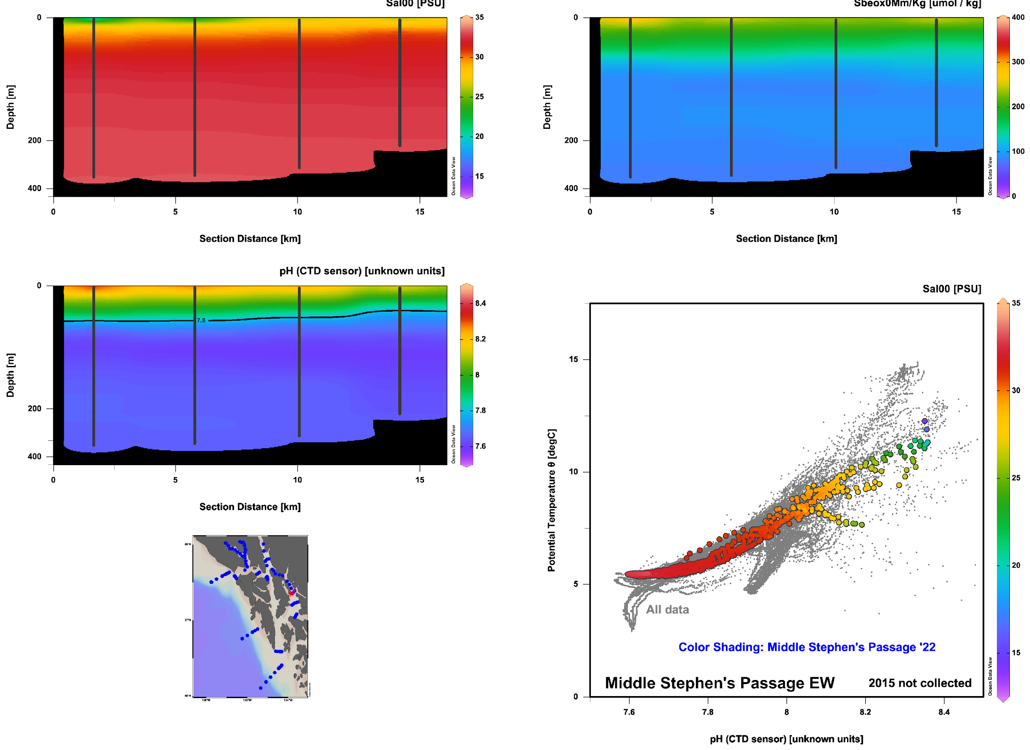
2022 Notable Features Middle Stephens Passage E/W
Gambier Bay (river discharge) has a higher pH than outside Tracy Arm (glacier discharge)
Rivers
Glaciers
Rivers
Glaciers

Slide 20
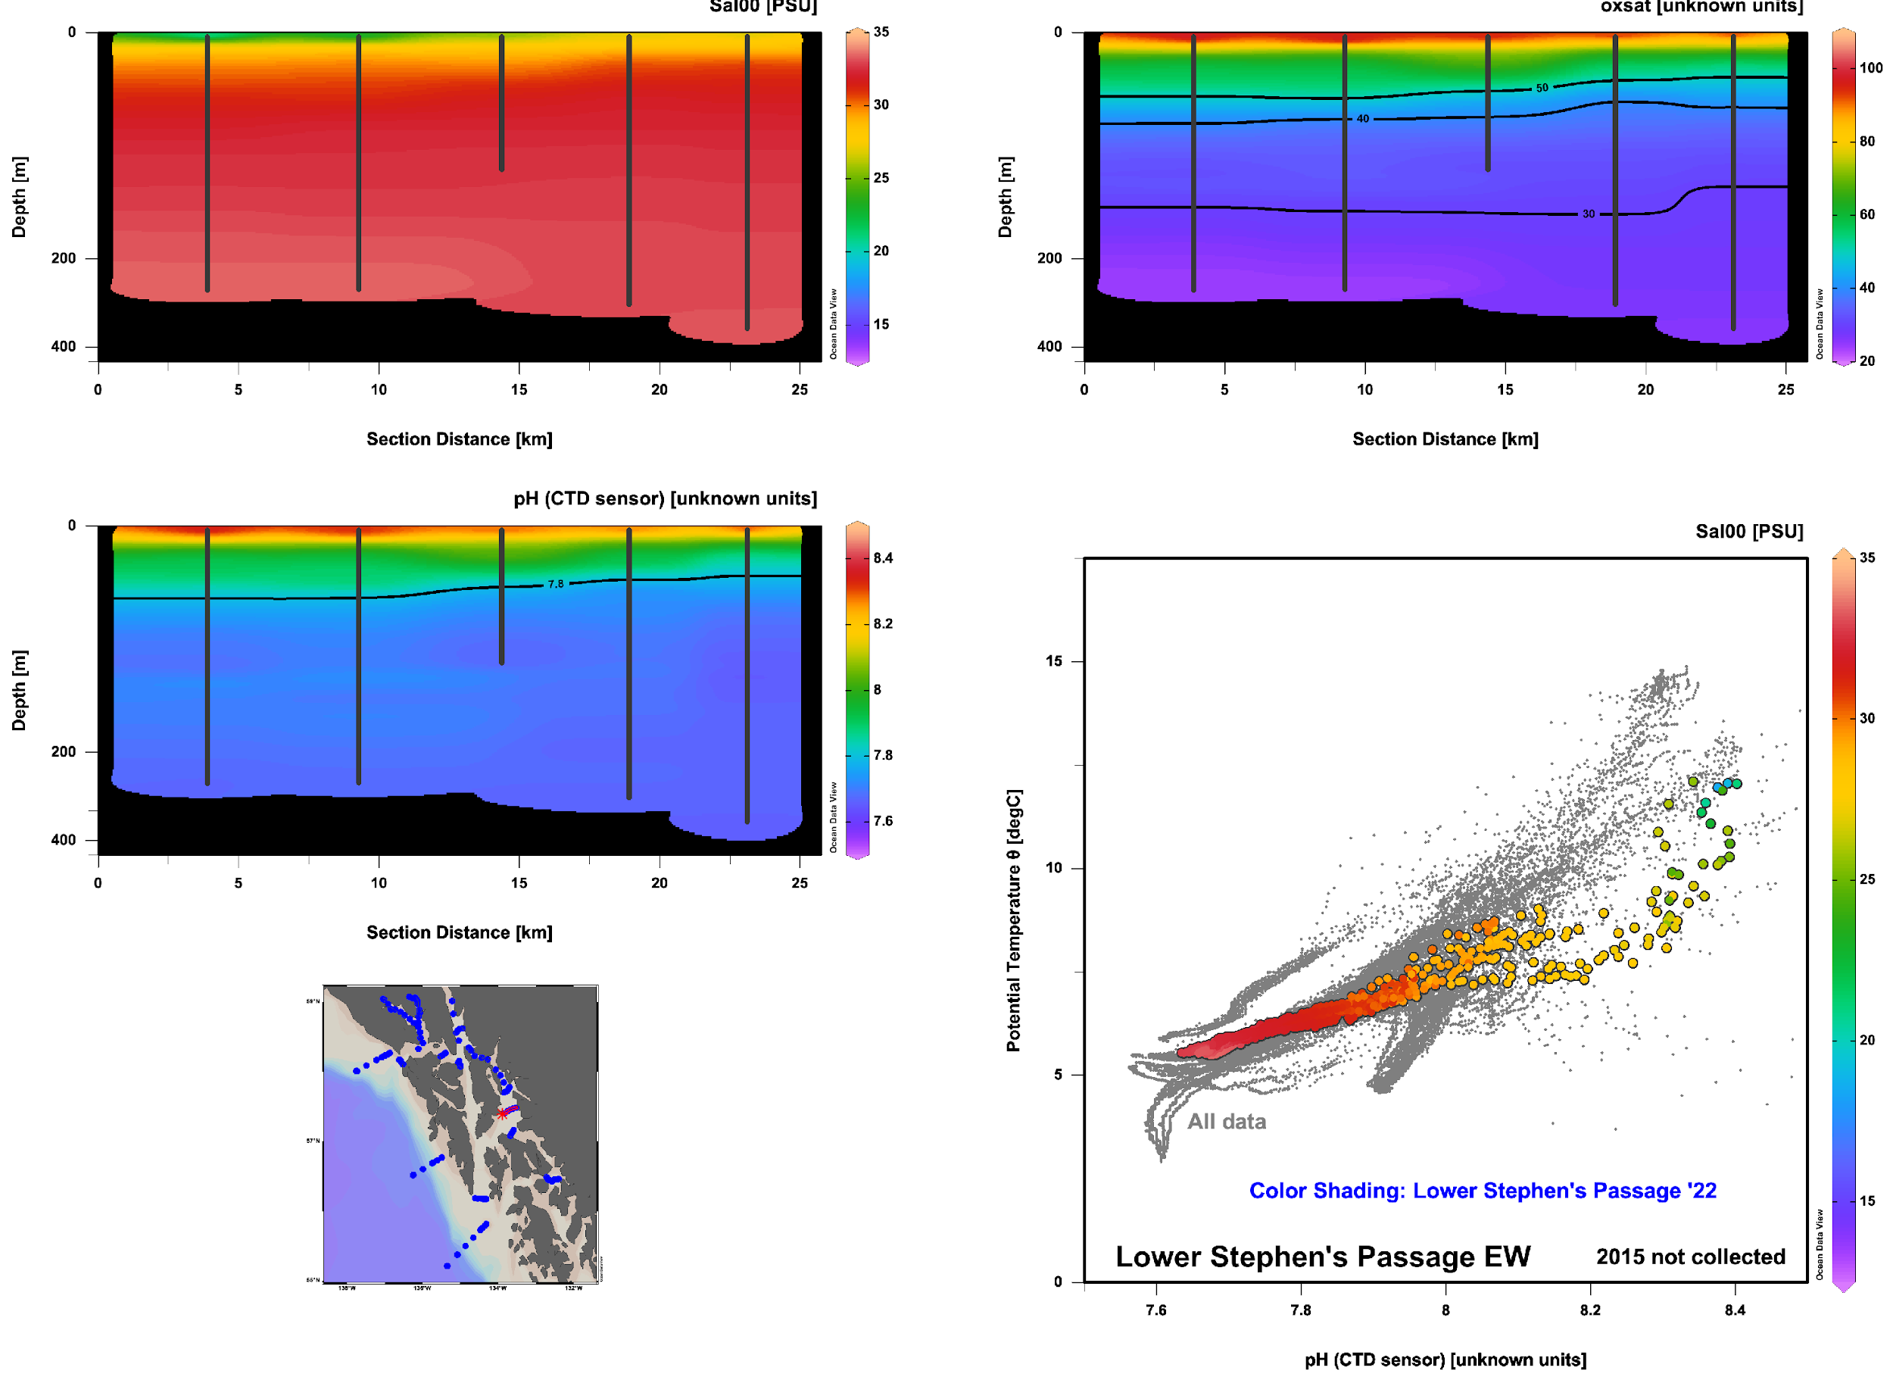
2022 Notable Features Lower Stephens Passage E/W:
Glacial influence at middepths?

Slide 21
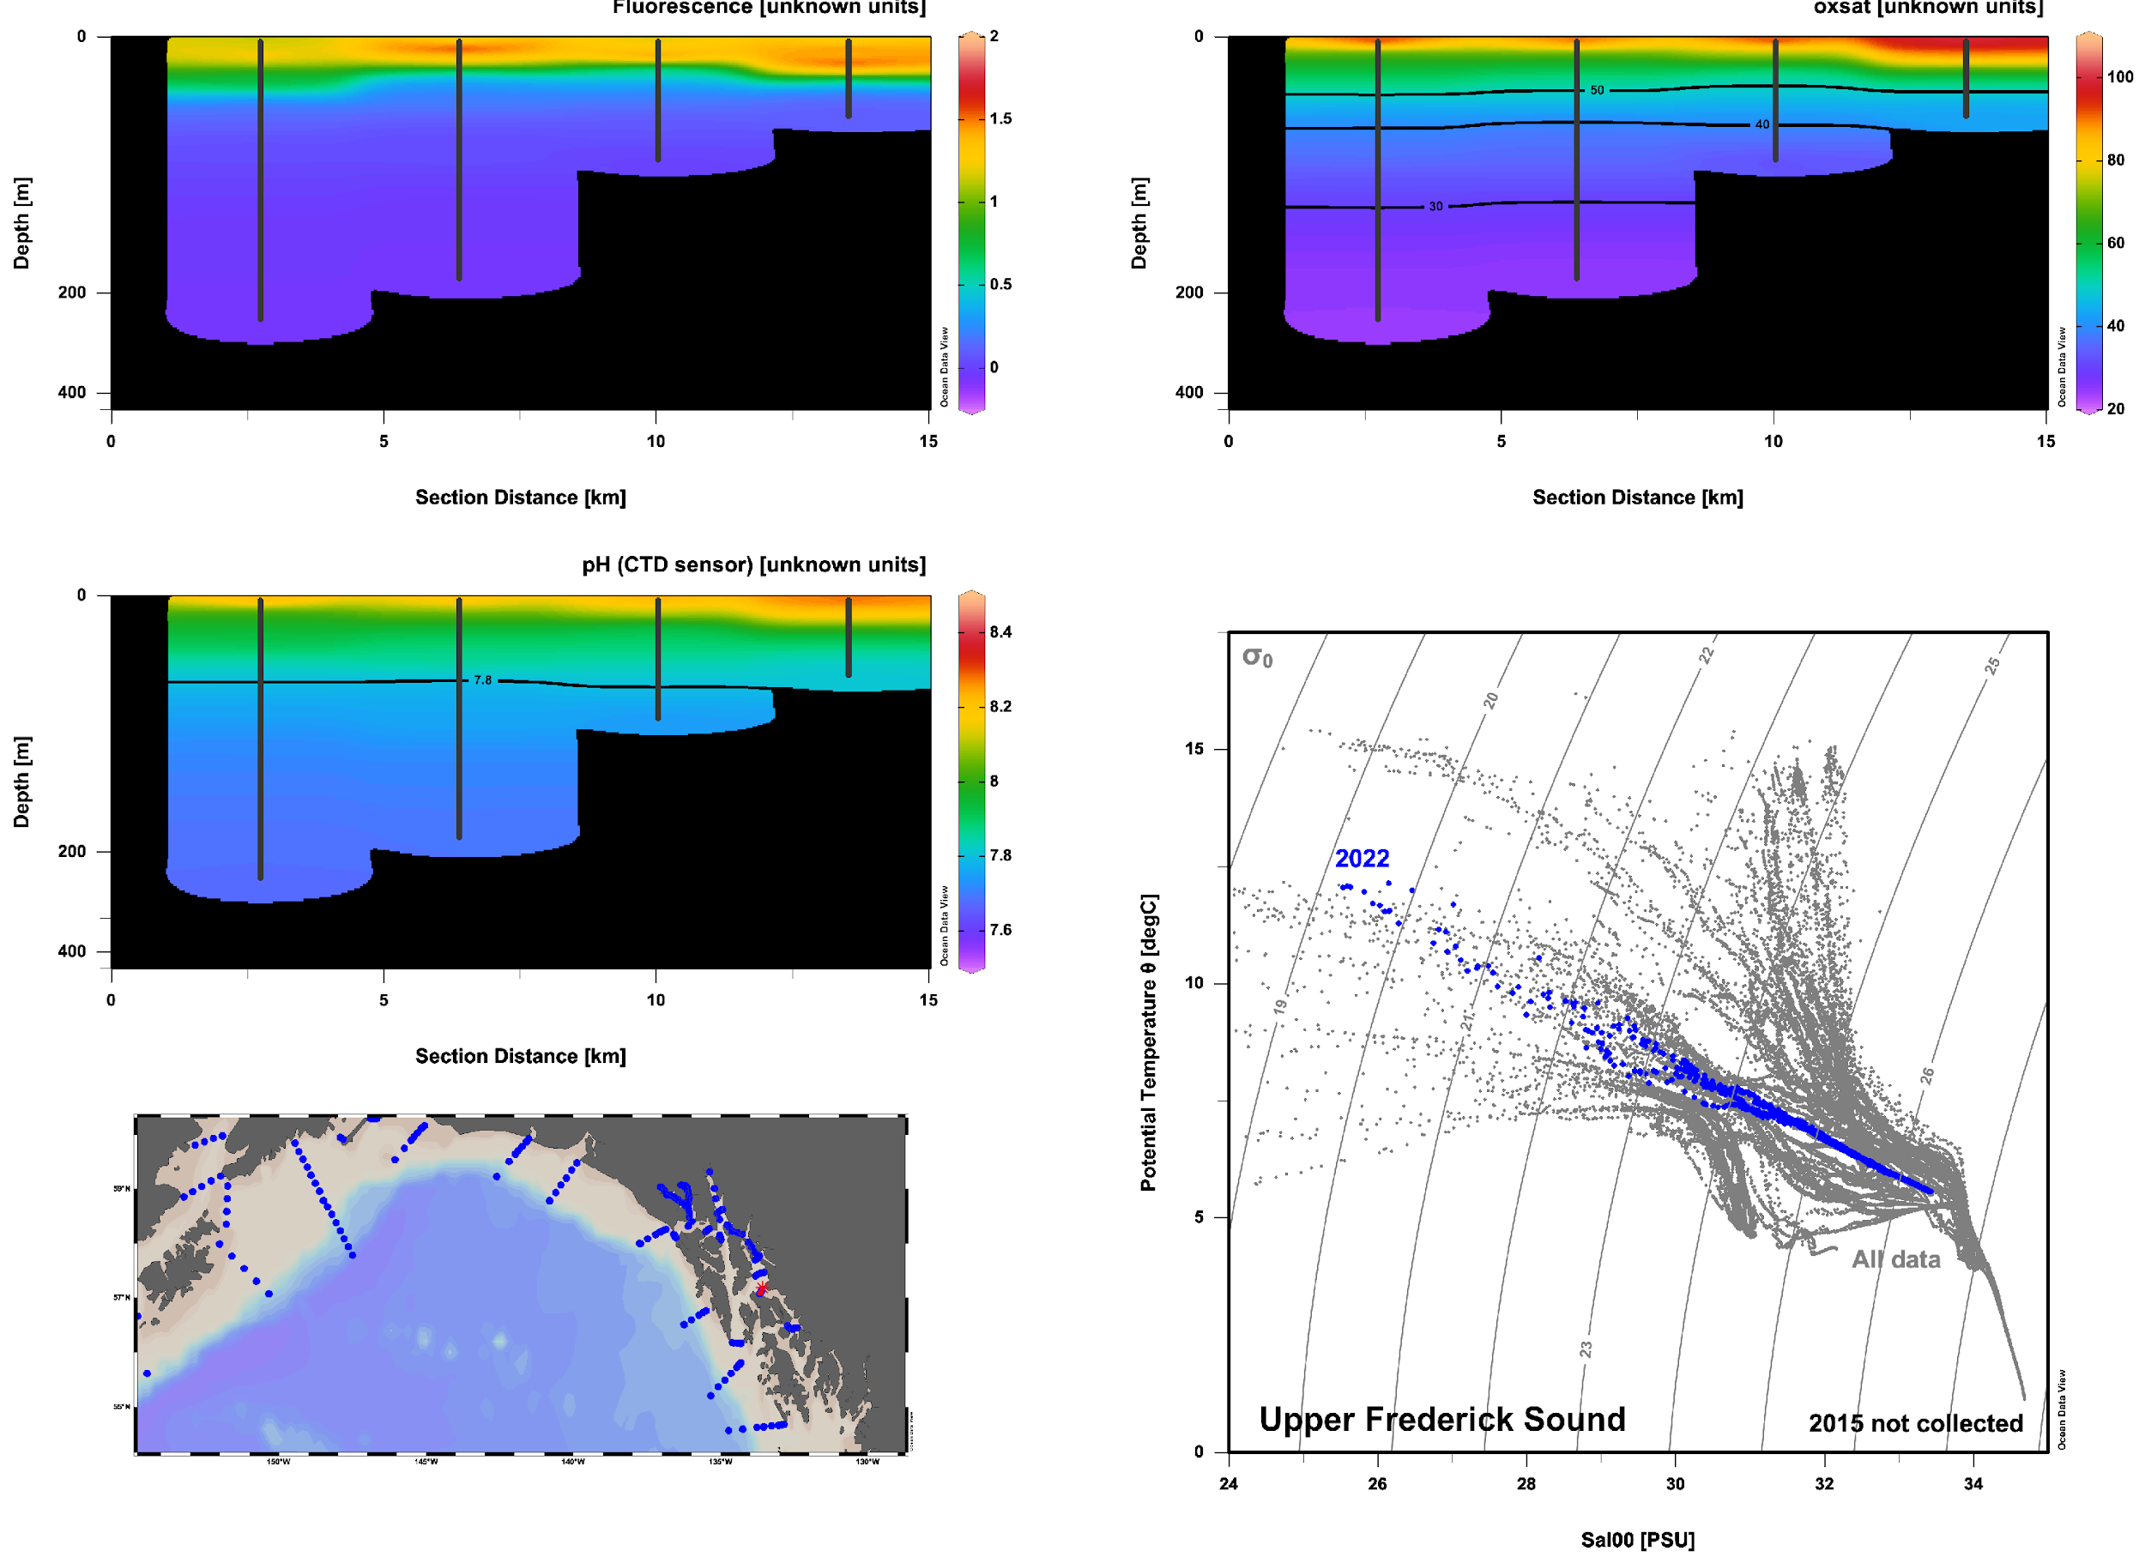
2022 Notable Features Upper Frederick Sound: surface bloom

Slide 22
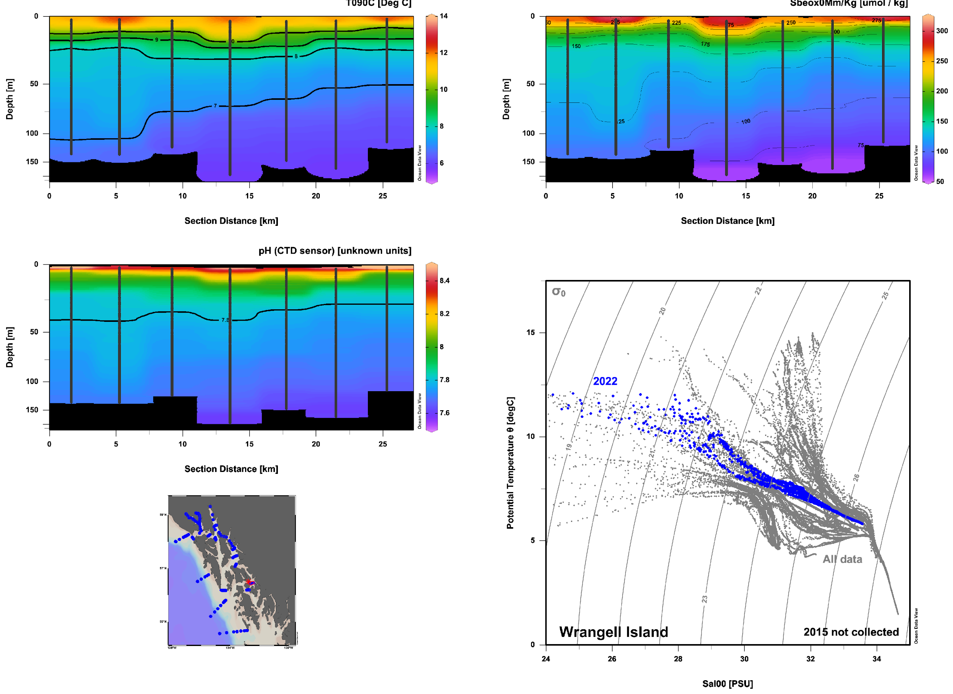
2022 Notable Features Wrangell Island: 3 straits meet; very shallow saturation horizon at Zimovia
Sumner
Stikine
Zimovia

Slide 23
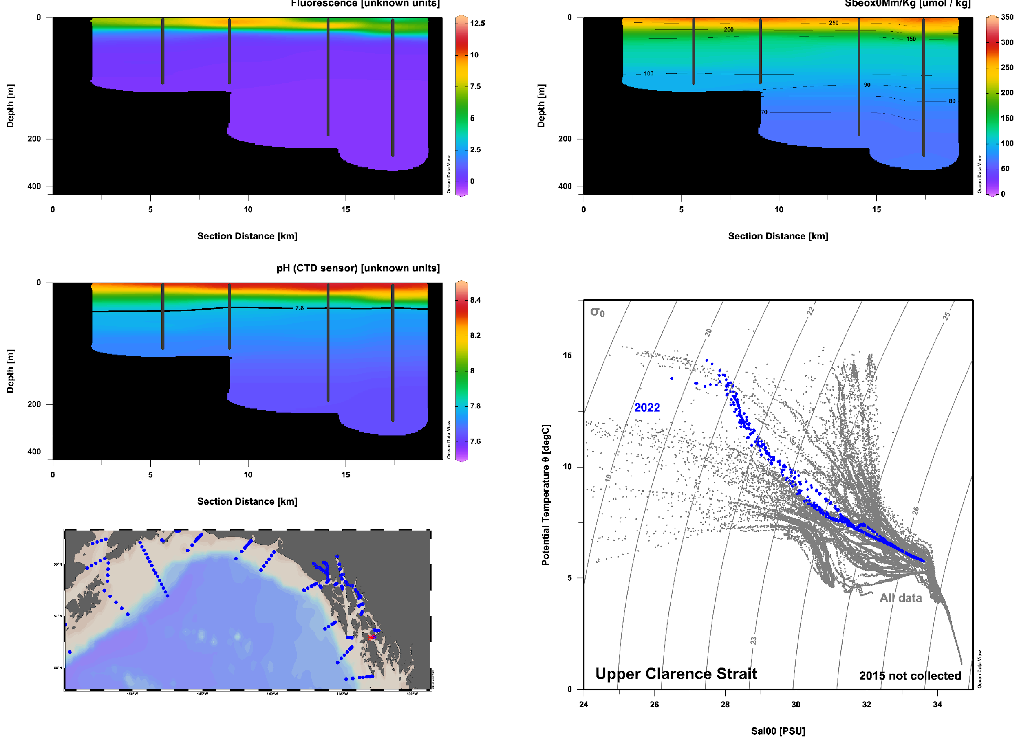
2022 Notable Features Upper Clarence Strait:
Warm surface water and widespread productivity; v. shallow saturation horizon again

Slide 24
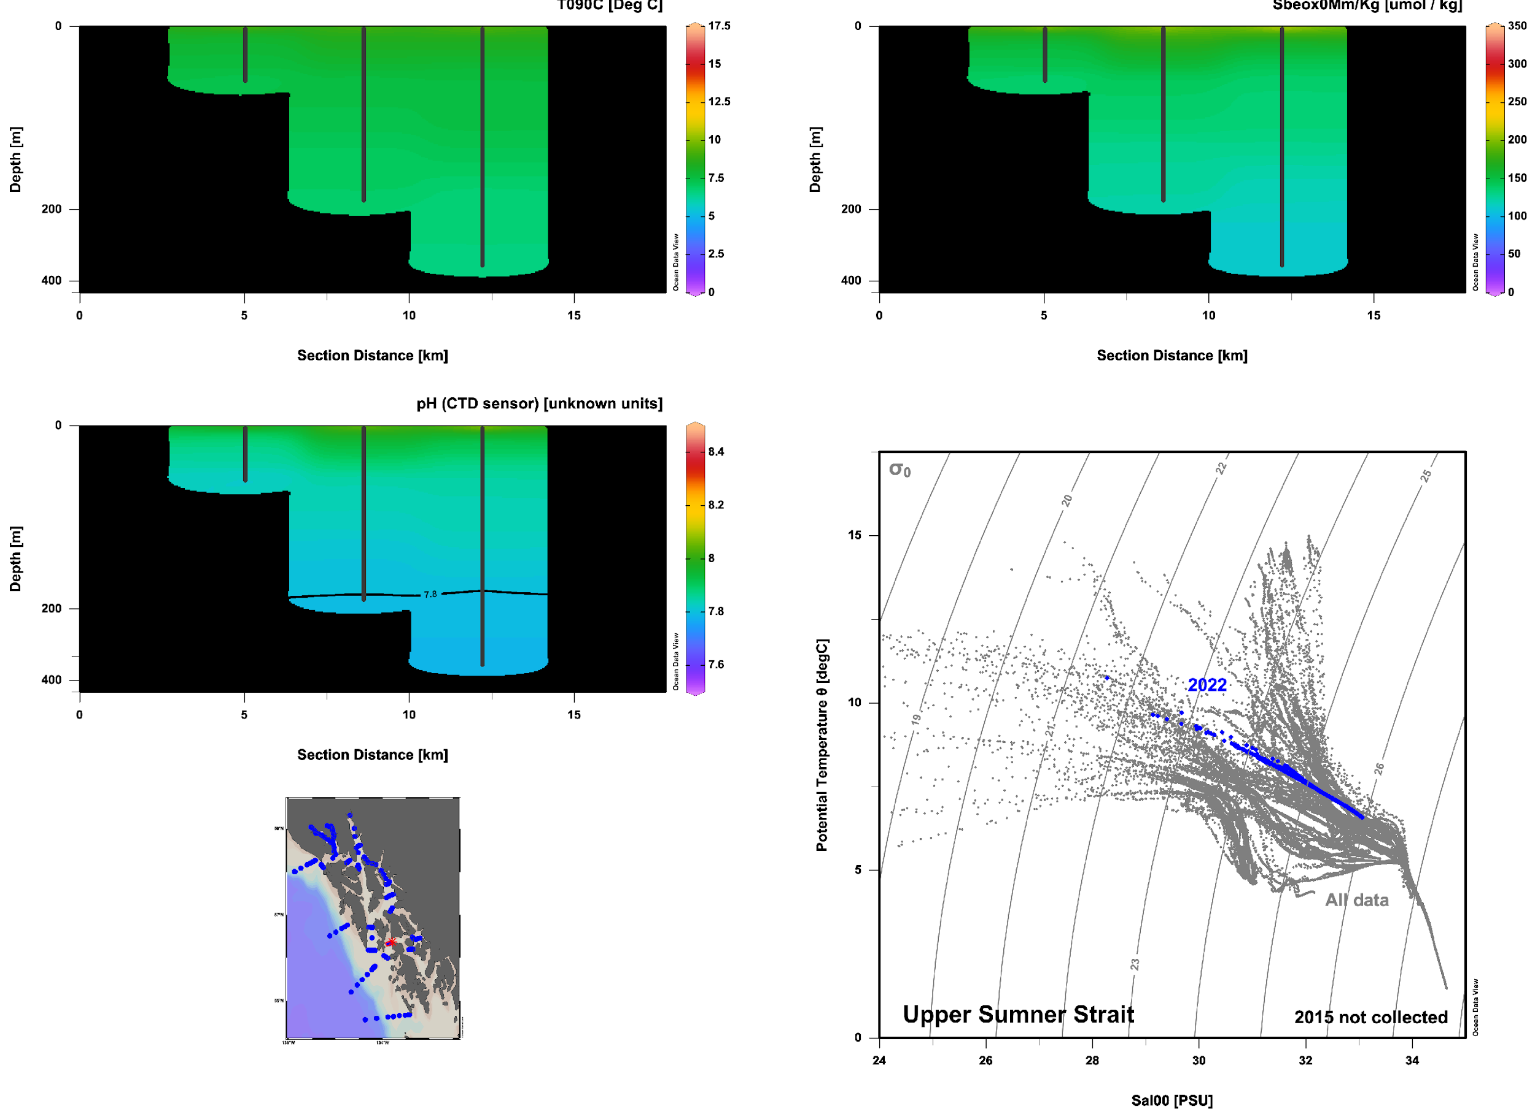
2022 Notable Features Upper Sumner Strait: Well mixed; low pH isolated to deeper waters

Slide 25
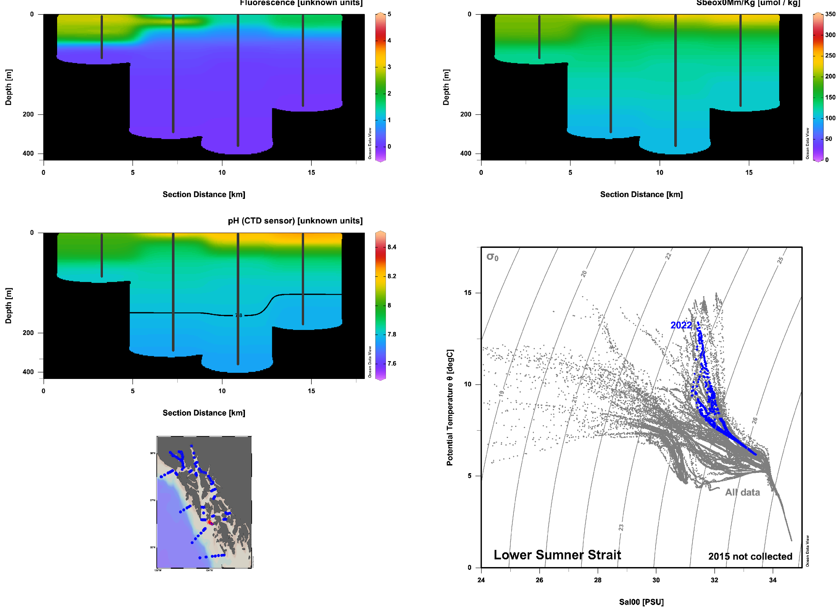
2022 Notable Features Lower Sumner Strait: new bloom?
High F + low O2 could be dead bloom, but pH would likely remain elevated. High F + low O2 + low pH may indicate a new bloom just taking off.

Slide 26
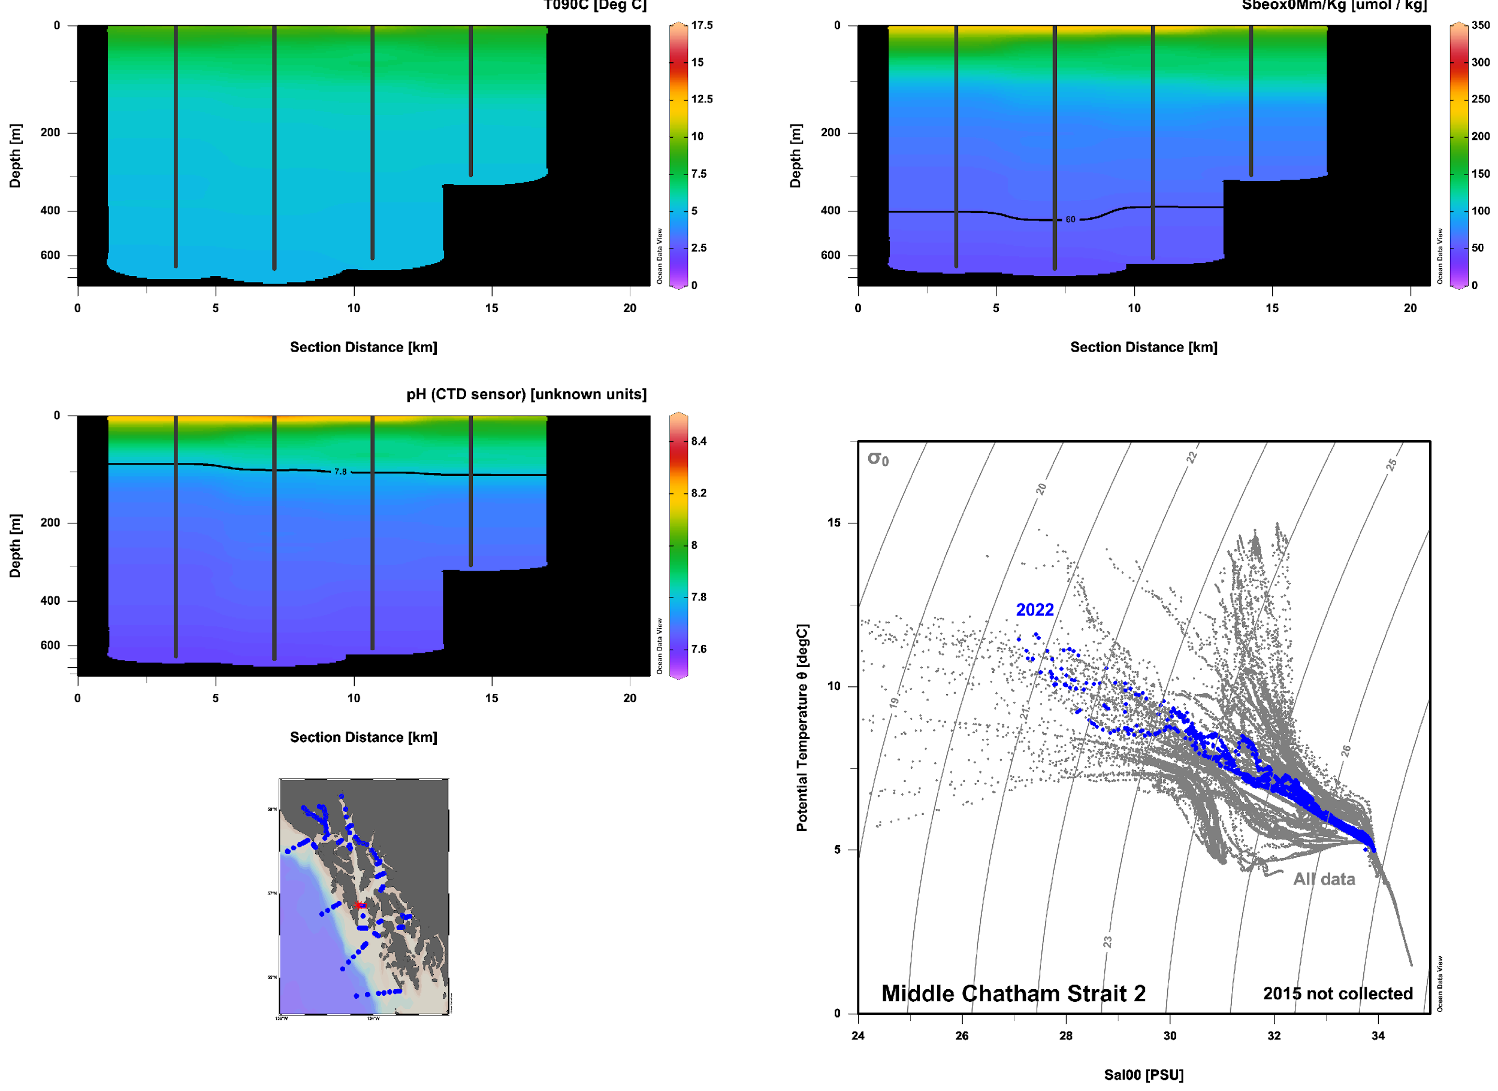
2022 Notable Features Lower Chatham Strait (MCS2 series): Hypoxic bottom water, but low pH as shallow as 100m

Slide 27
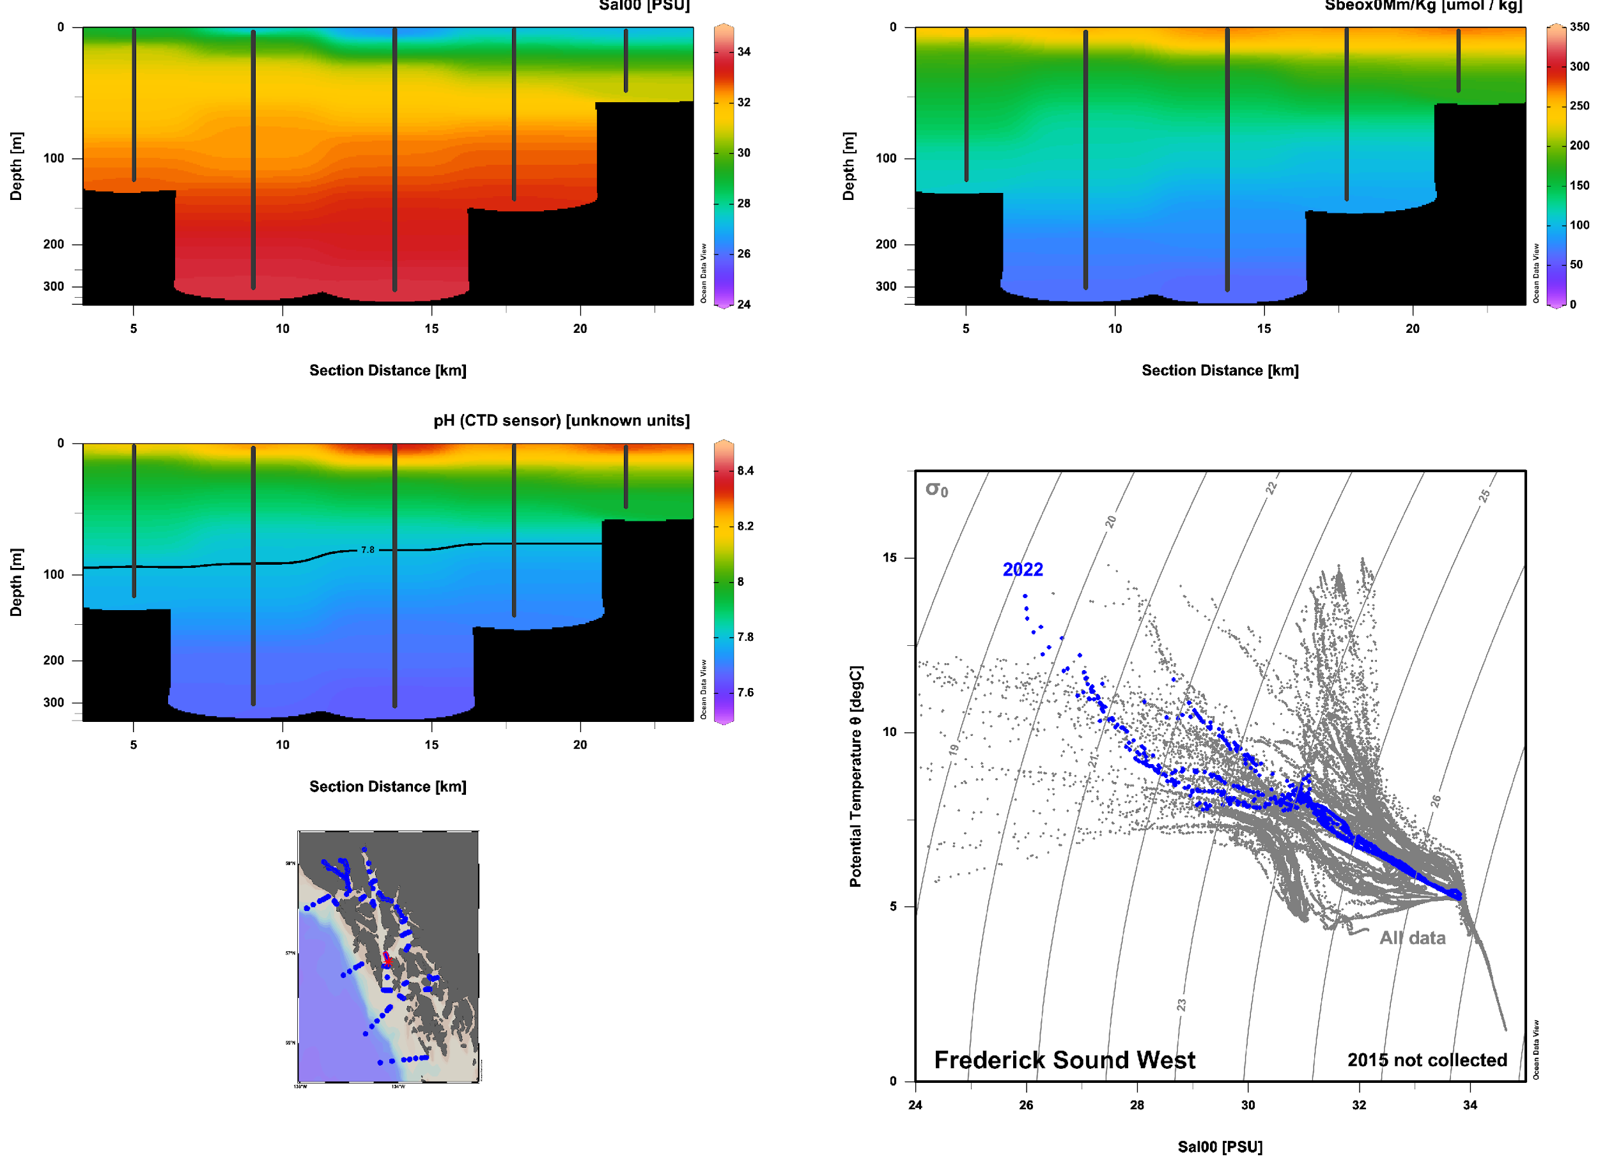
2022 Notable Features Frederick Sound West:
Freshwater N side, ocean water S side
Terrestrial
Ocean

Slide 28
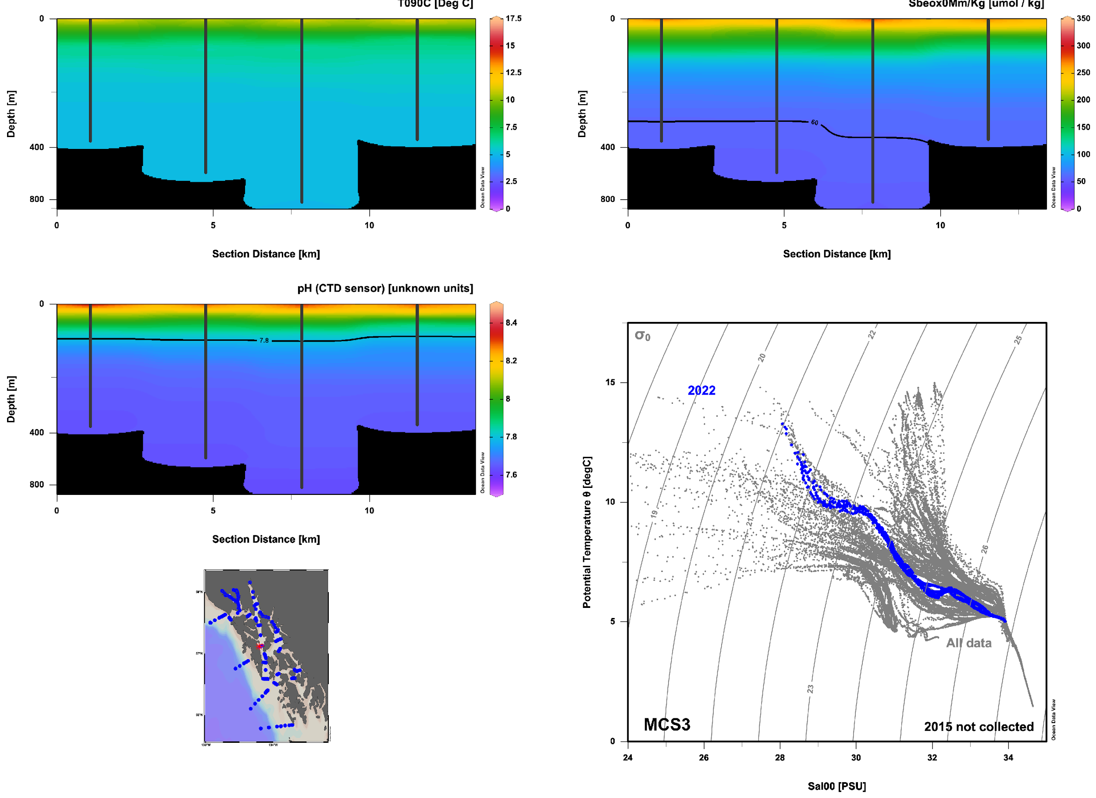
2022 Notable Features Middle Chatham Strait (MCS3 series): Stratified, no noticeable E/W differences

Slide 29
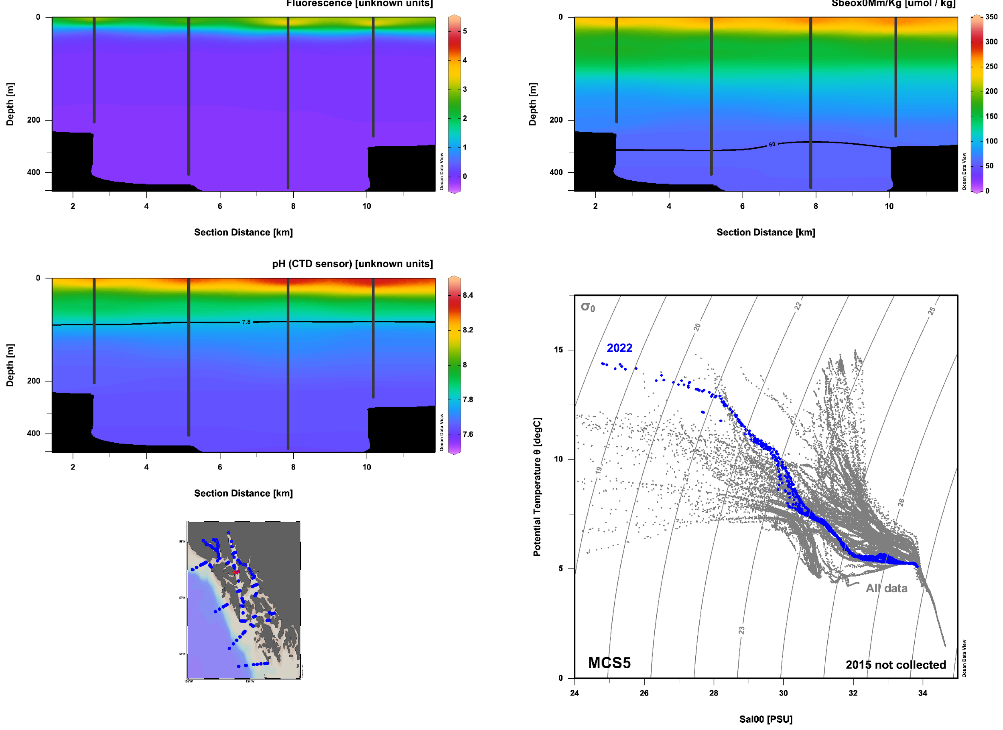
2022 Notable Features Middle Chatham Strait (MCS5 series): Optimum Stability? High fluorescence in low S surface layer

Slide 30
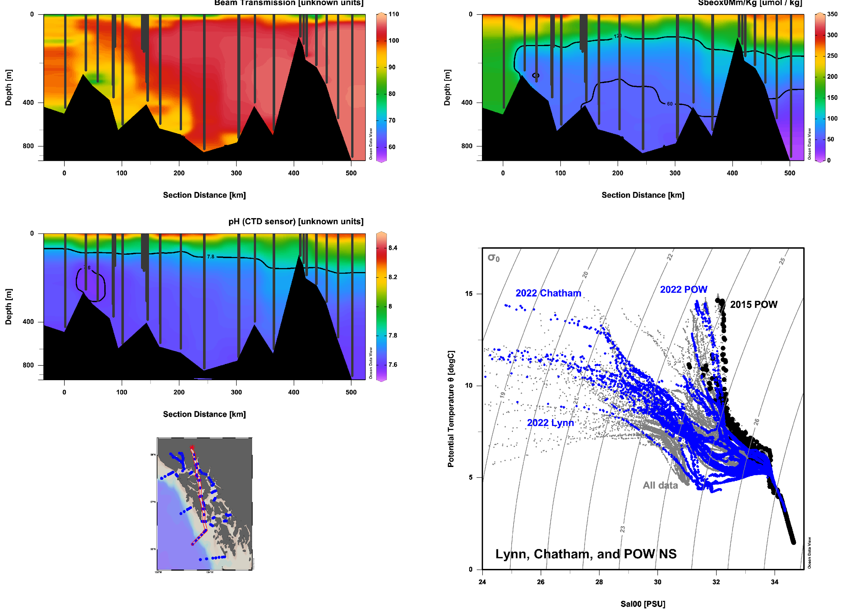
2022 Notable Features N/S Lynn + Chatham + POW:
--Consistent flushing with low pH water
--Remineralization of terrestrial OM at head of Lynn? Glacial silt vertical export?

Slide 31
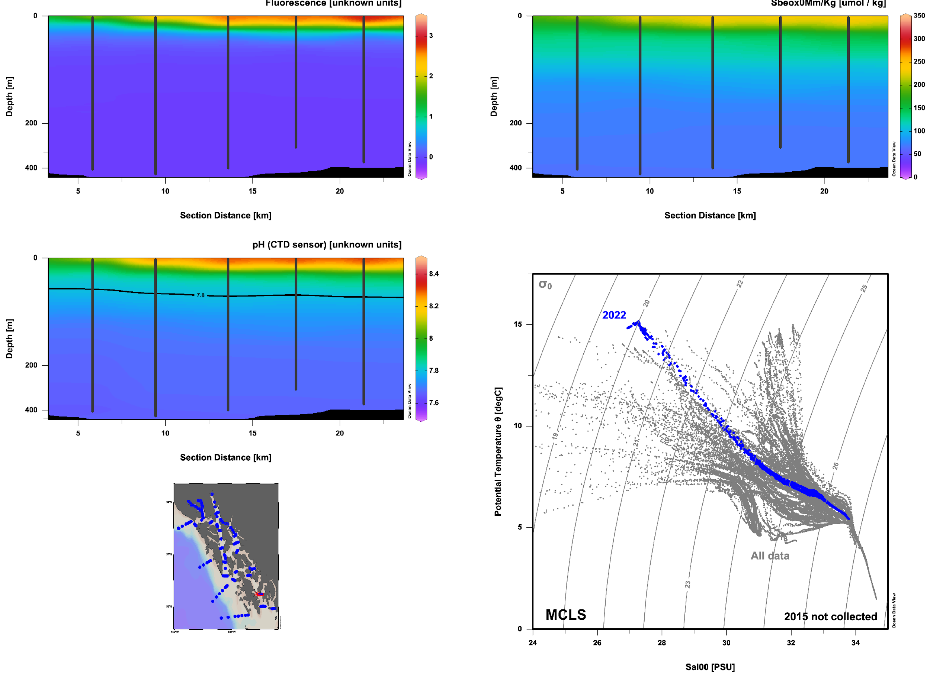
2022 Notable Features Middle Clarence Strait:
Surface productivity in fresh surface plume: Optimum stability?

Slide 32
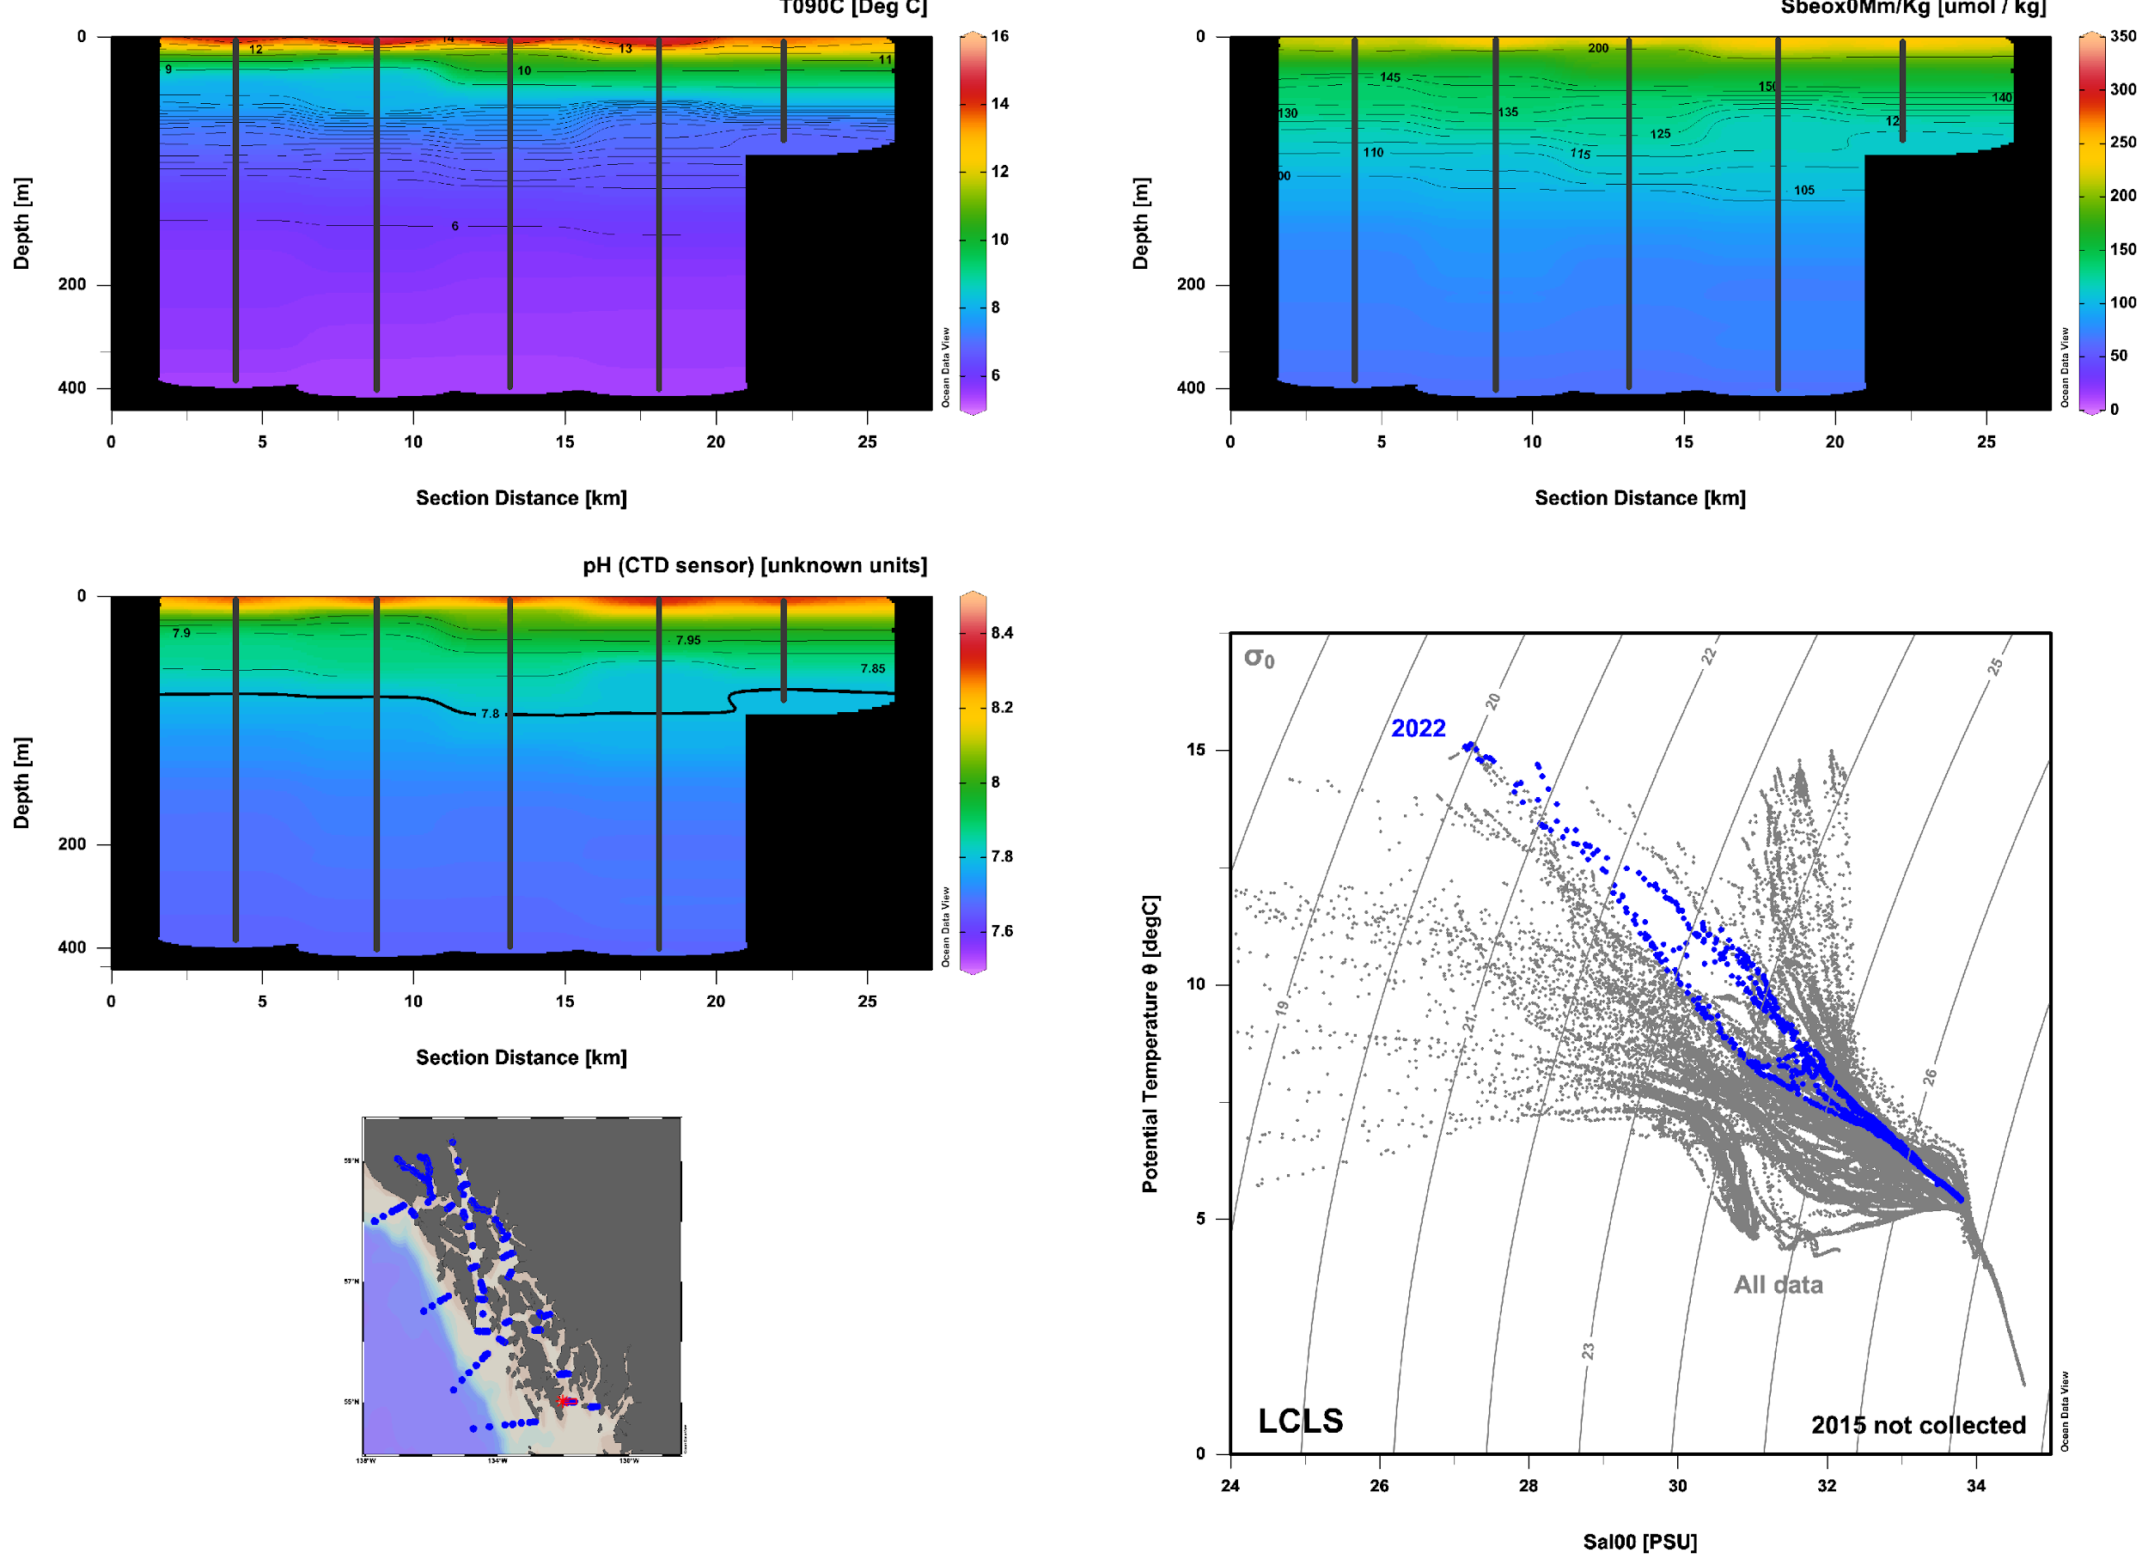
2022 Notable Features Lower Clarence Strait:
Topographic influences

Slide 33
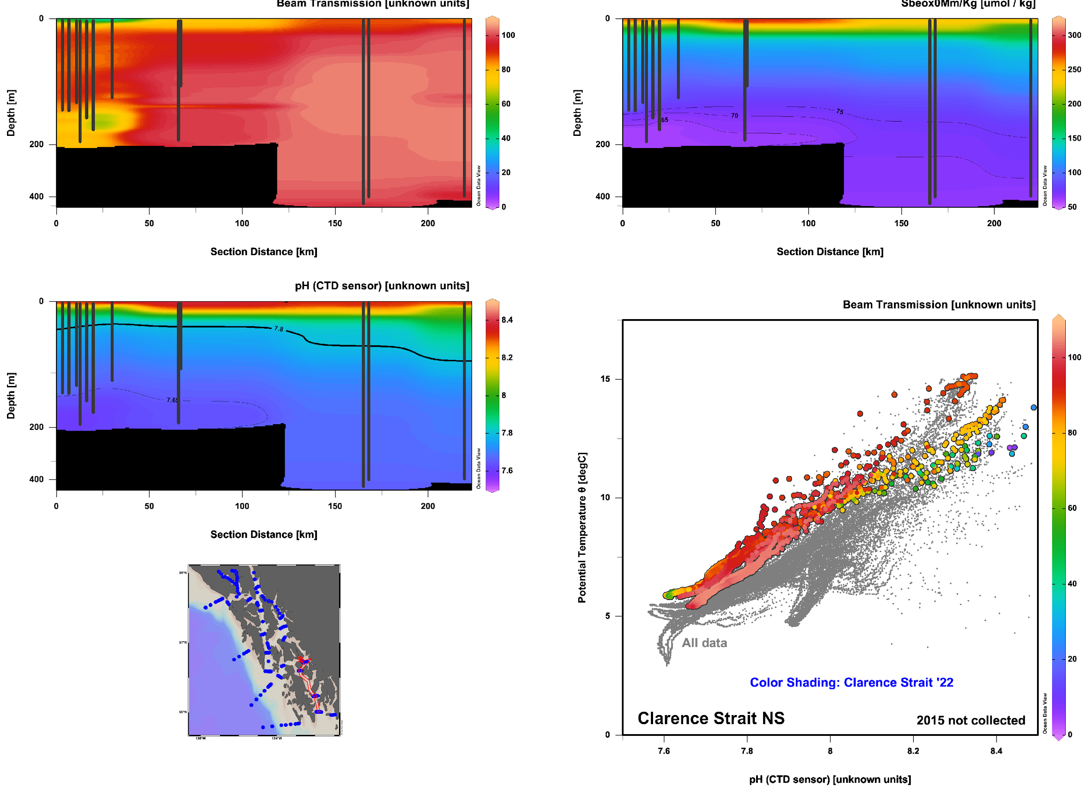
2022 Notable Features Clarence Strait N-S
Shallow low-pH feature from Wrangell not found offshore:
Topography drives shoaling of saturation horizon?
Biological pump exacerbates bottom pH / hypoxia at Wrangell:
Low beam transmission shows export of material to bottom waters
pH, O2 reduced relative to density / potential temperature
Wrangell
Clarence
Wrangell
Clarence
BGC Conditioning
W
C

Slide 34
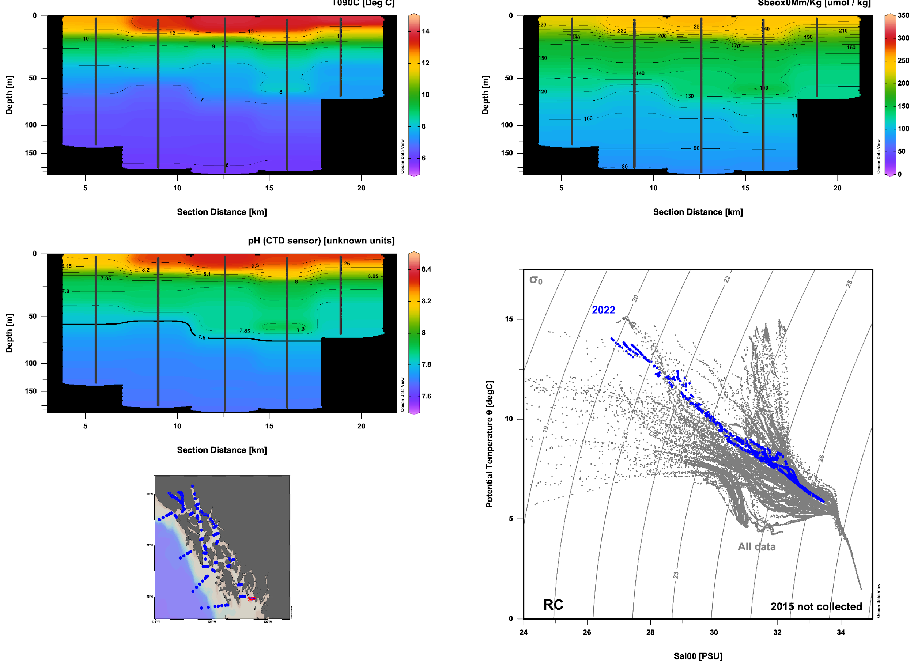
2022 Notable Features Revillagigedo Canal:
Downwelling eddy near shelf break?

Slide 35
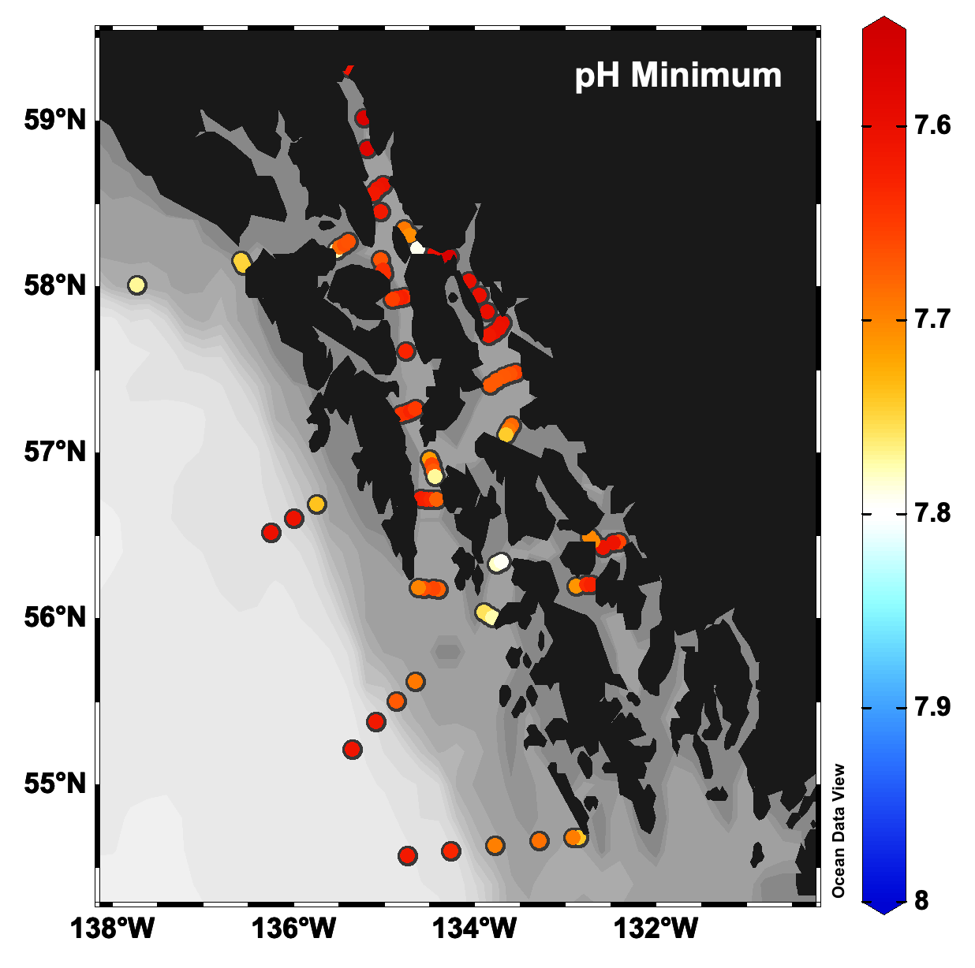
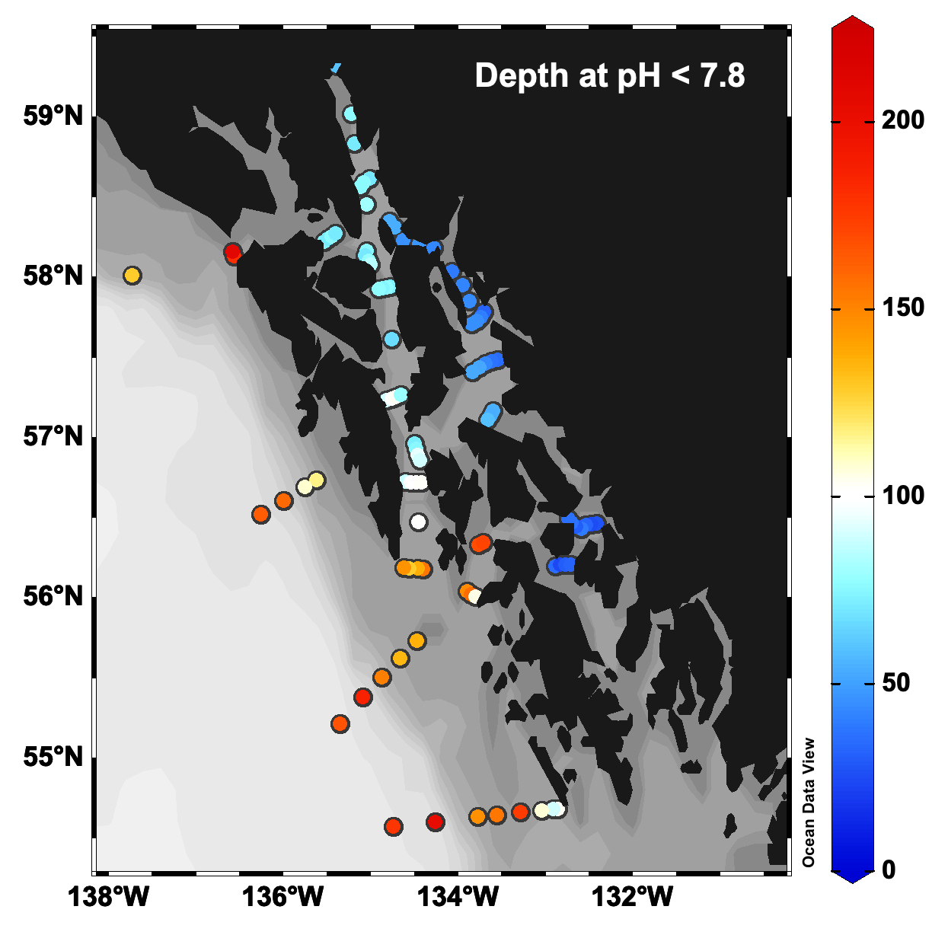
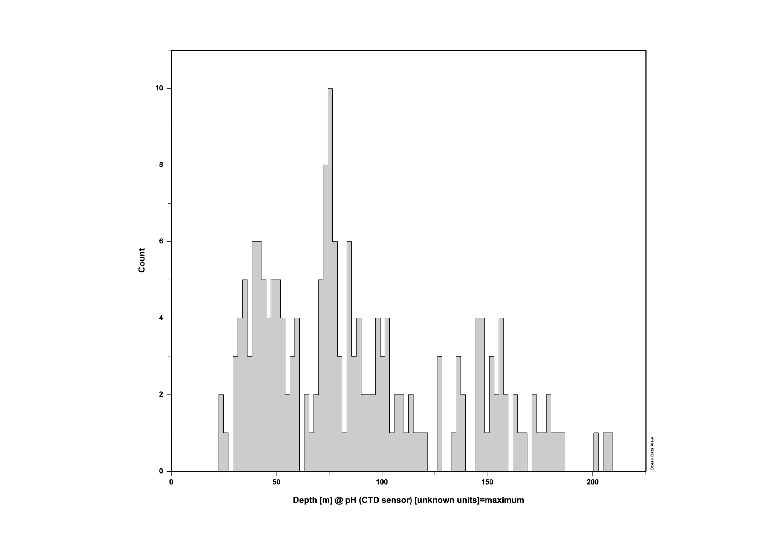



Qualifying Data Only
Depth of Horizon
Horizon <50m
Horizon 50m – 100m
2022 Notable Features Minimum pH and oxygen concentrations
Corrosive: pH < 7.8
horizon v. shallow in interior
(24 m minimum near Wrangell!)
Hypoxia: < 60 umol O₂ kg⁻¹
only 1 shallow (100 m) instance of hypoxia (Also near Wrangell)
Visit Clarence Strait on the way back to Seattle to look for more shallow corrosivity / hypoxia
Depth of 7.8 pH Horizon
Histogram
Horizon 100m – 200m
Depth of 60 umol O₂ kg⁻¹ Horizon
Histogram

Slide 36




Horizon <50m
Horizon 50m – 100m
2022 Notable Features Minimum pH and oxygen concentrations
Corrosive: pH < 7.8
horizon v. shallow in interior
(24 m minimum near Wrangell!)
Hypoxia: < 60 umol O₂ kg⁻¹
only 1 shallow (100 m) instance of hypoxia (Also near Wrangell)
Depth of 7.8 pH Horizon
Histogram
Horizon 100m – 200m
Depth of 60 umol O₂ kg⁻¹ Horizon
Histogram

Slide 37


POW 2015
CS 2015
POW 2022
CS 2022

